Slide 1
2017-219301
6818 62nd Avenue NE
#4303
Detective Kim Biggs
Certified Crime Scene Analyst

Slide 2
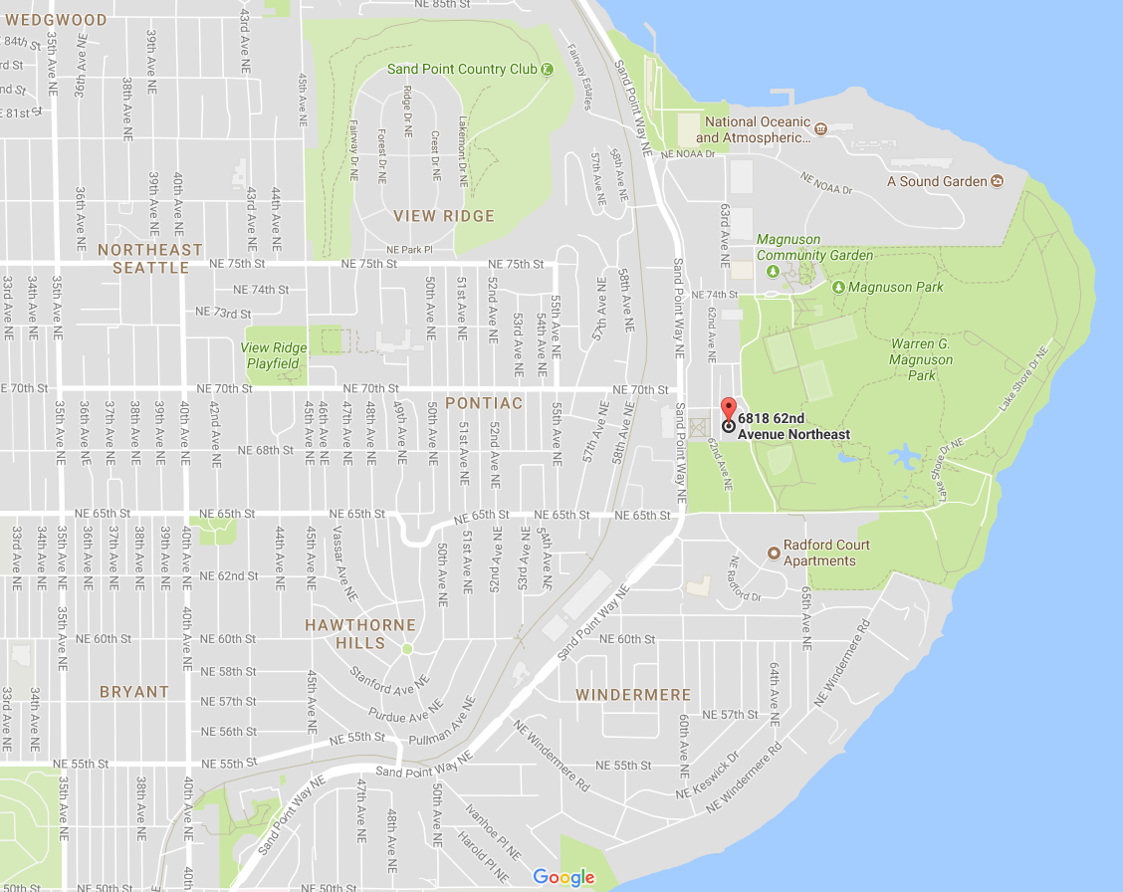
6818 62 Ave. NE

Slide 3
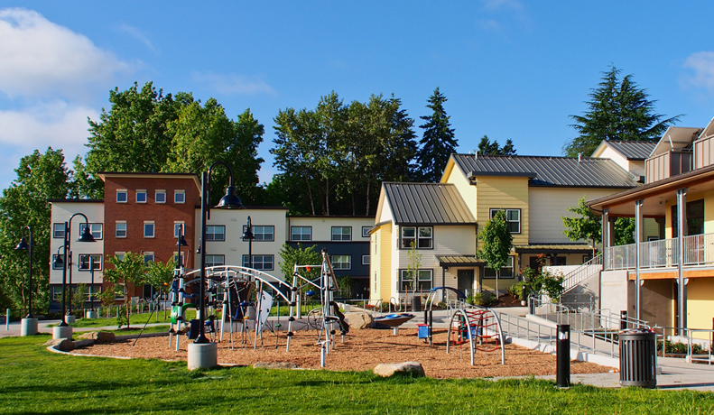
Brettler Family Place 3
“Brettler Family Place provides 21 units of affordable housing with supportive services for formerly homeless families.” www.solid-ground.org

Slide 4
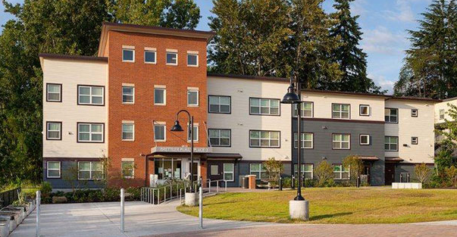
Brettler Family Place 3
Notes:
Perspective photographs were taken at each of the four placards. For consistency, the photos were taken from a standing position, at my eye level.
Nikkor 50mm lens

Slide 5
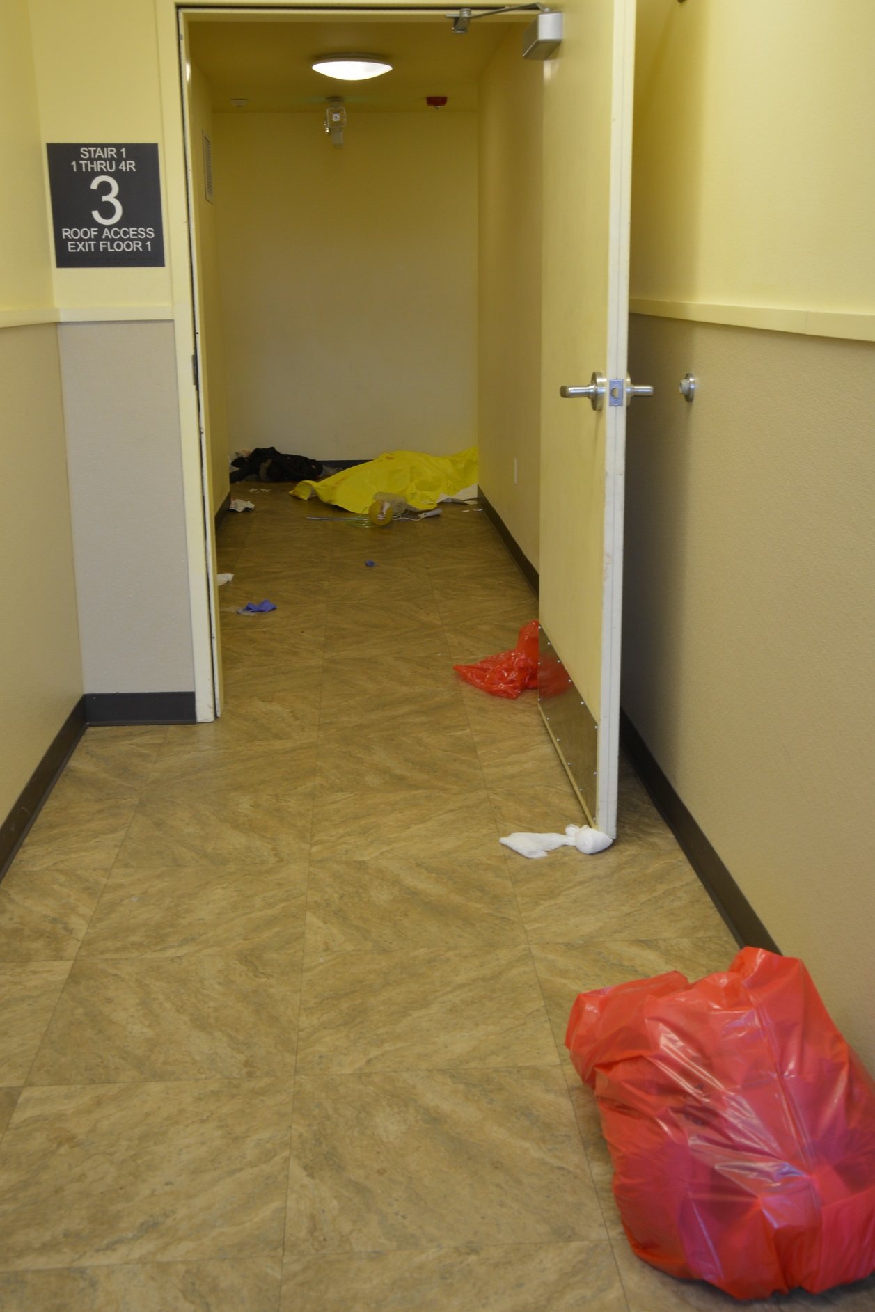

Slide 6
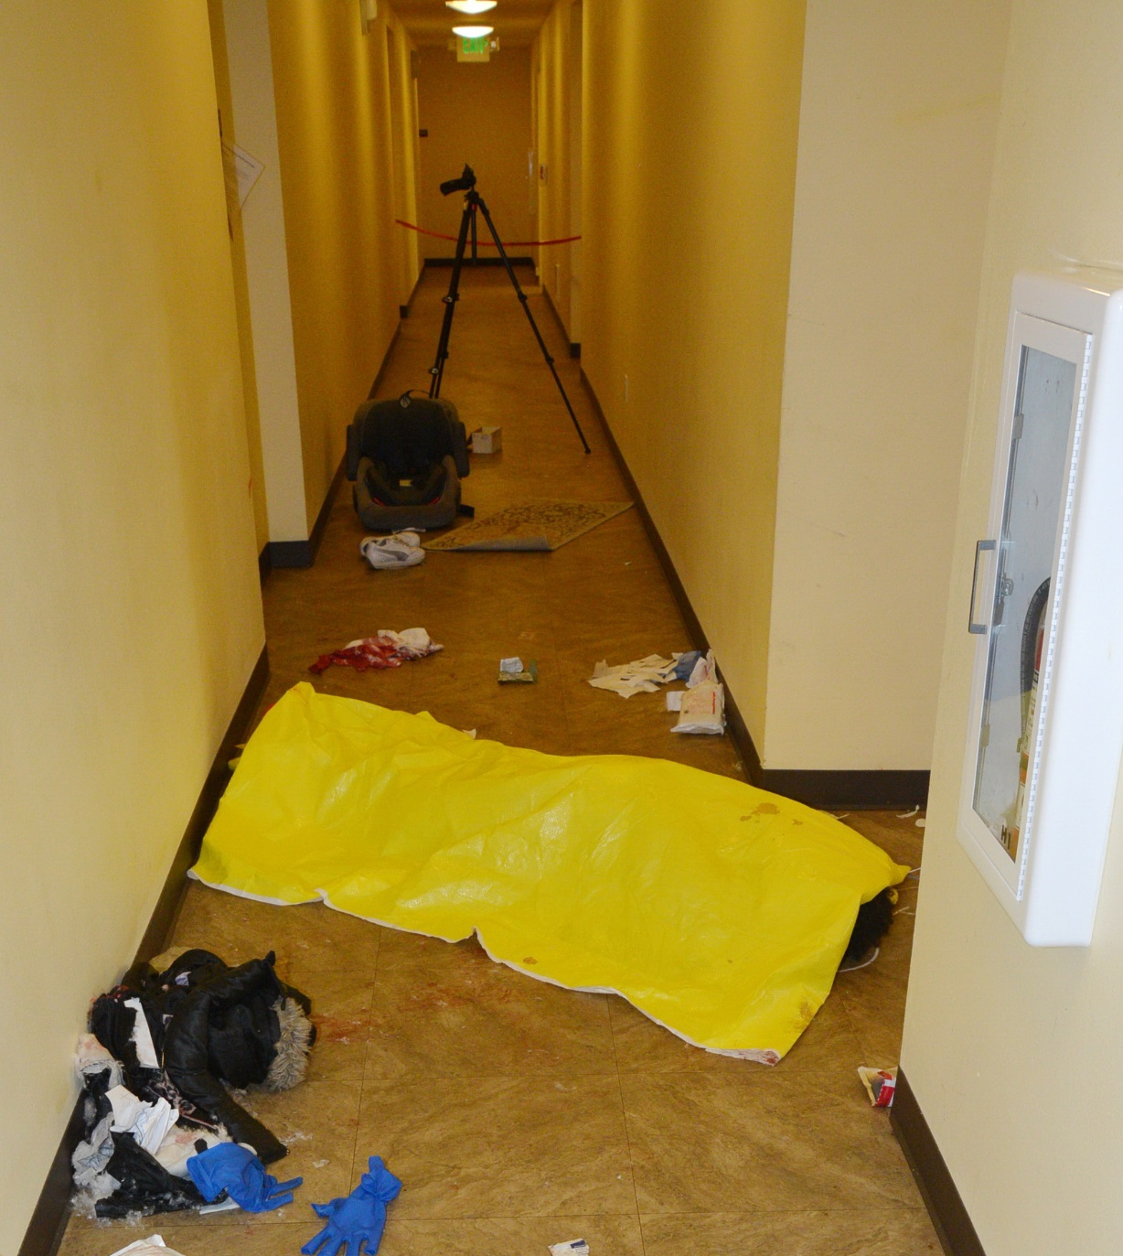

Slide 7
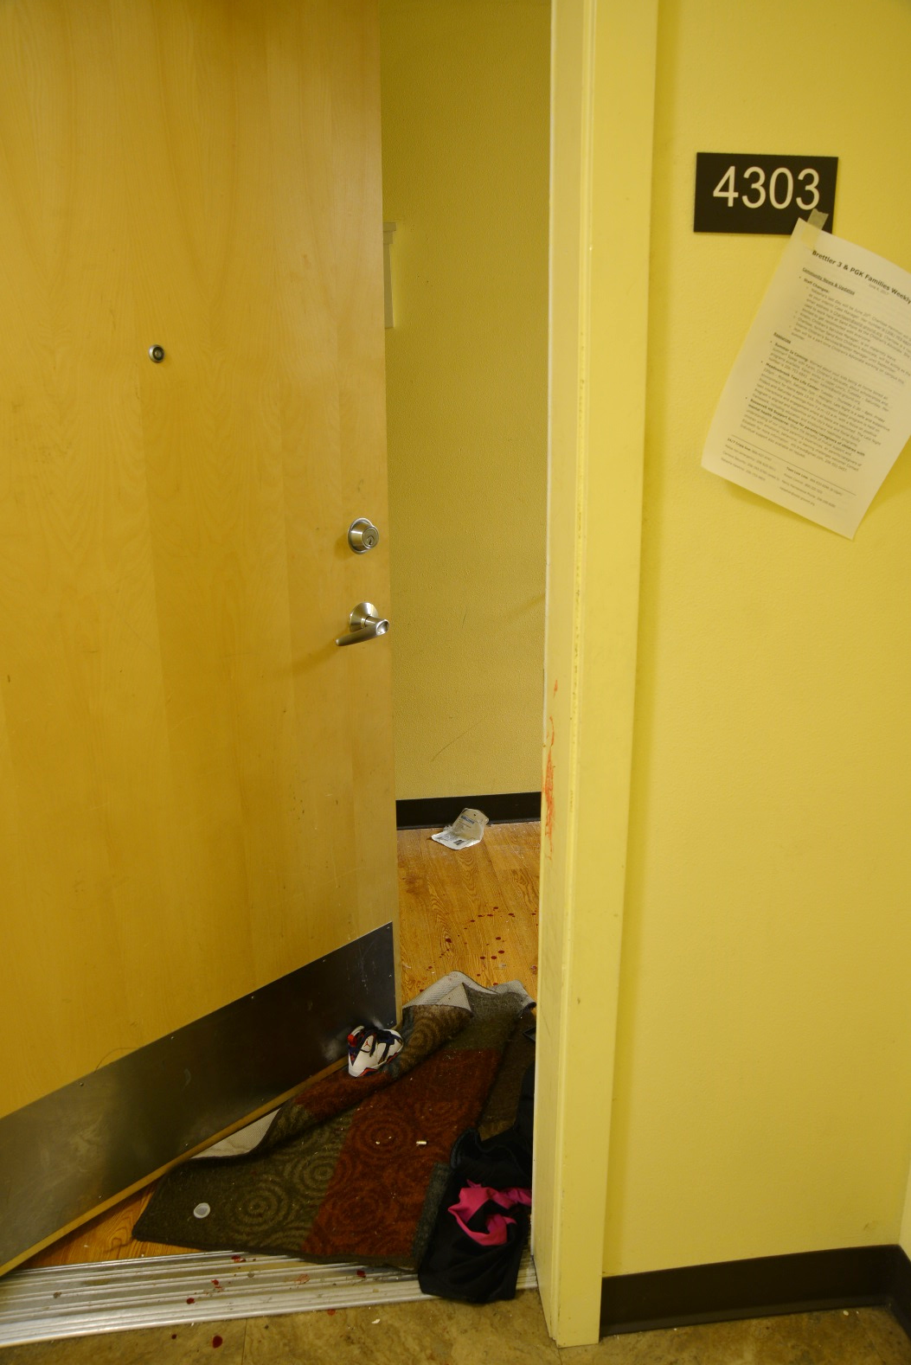

Slide 8
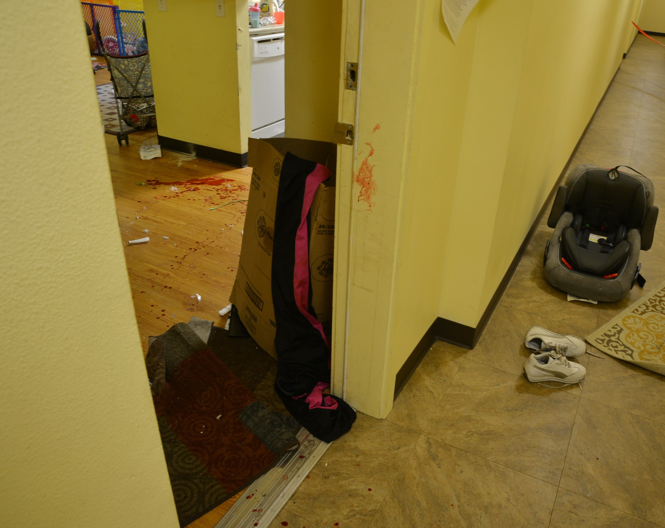

Slide 9
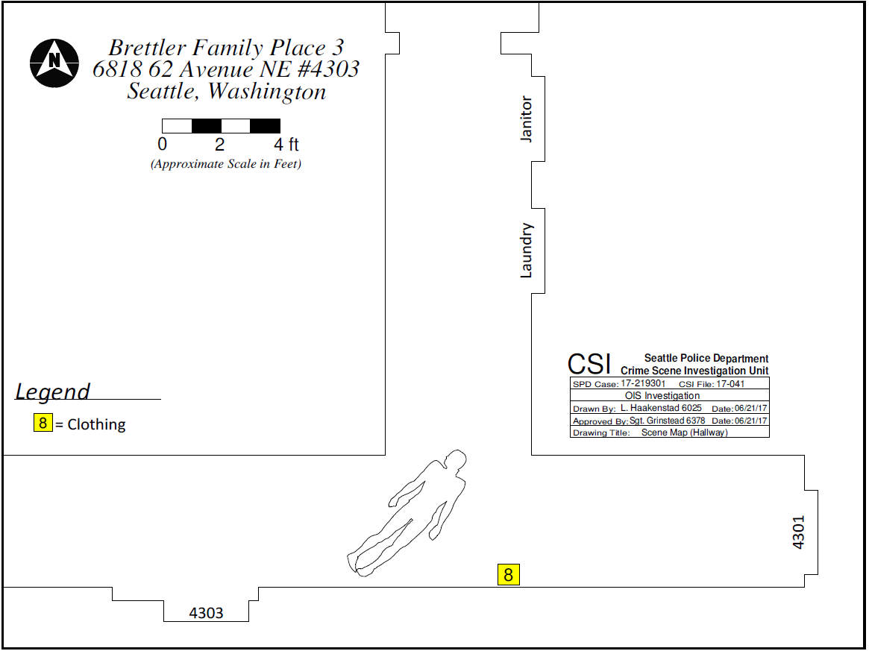
Charleena C. Lyles 04/24/1987

Slide 10
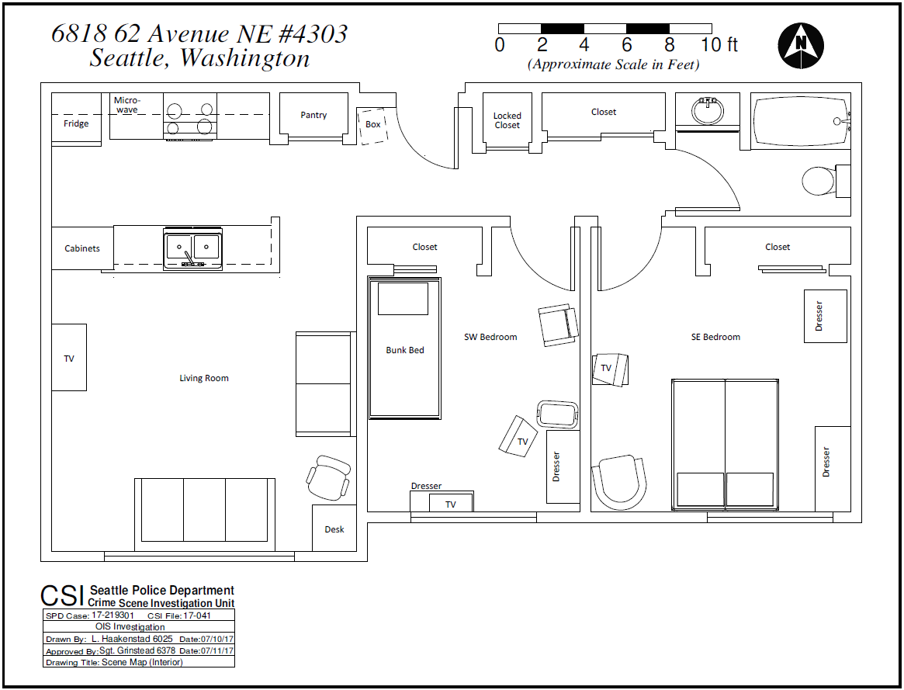
1
Kitchen
3.5 ft.
Temperature

Slide 11
Evidence

Slide 12
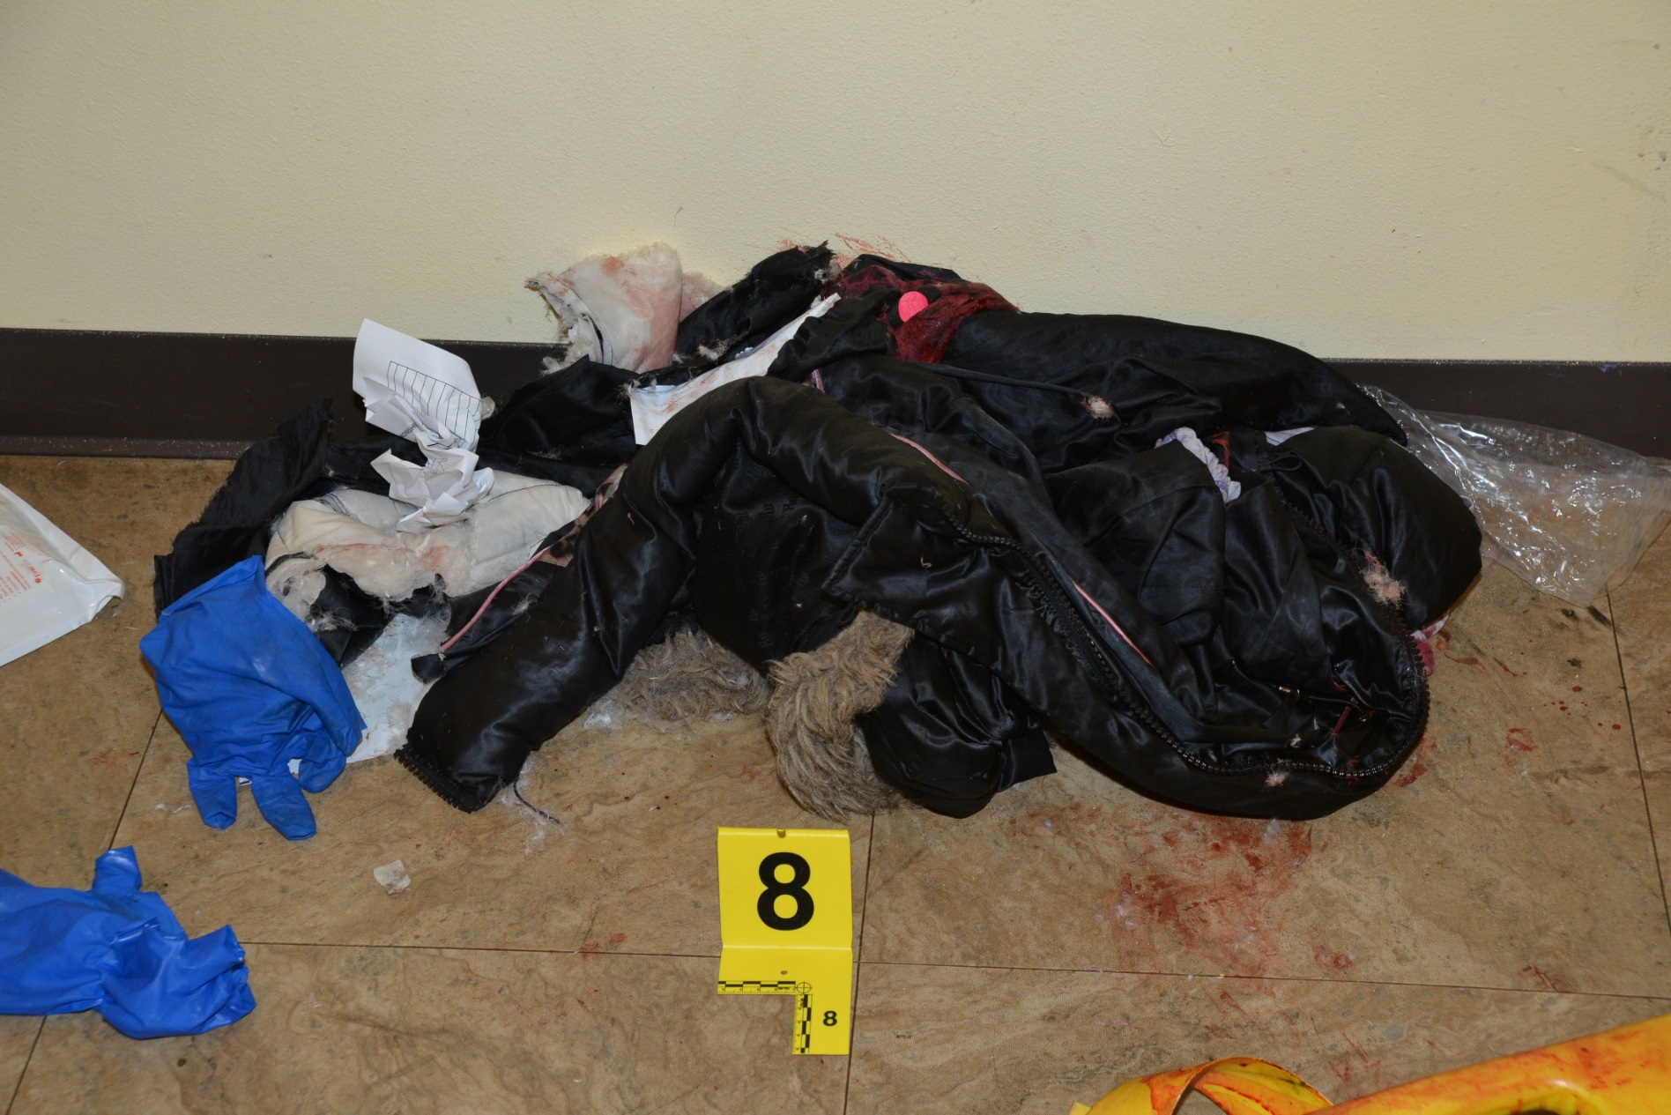
Clothing

Slide 13
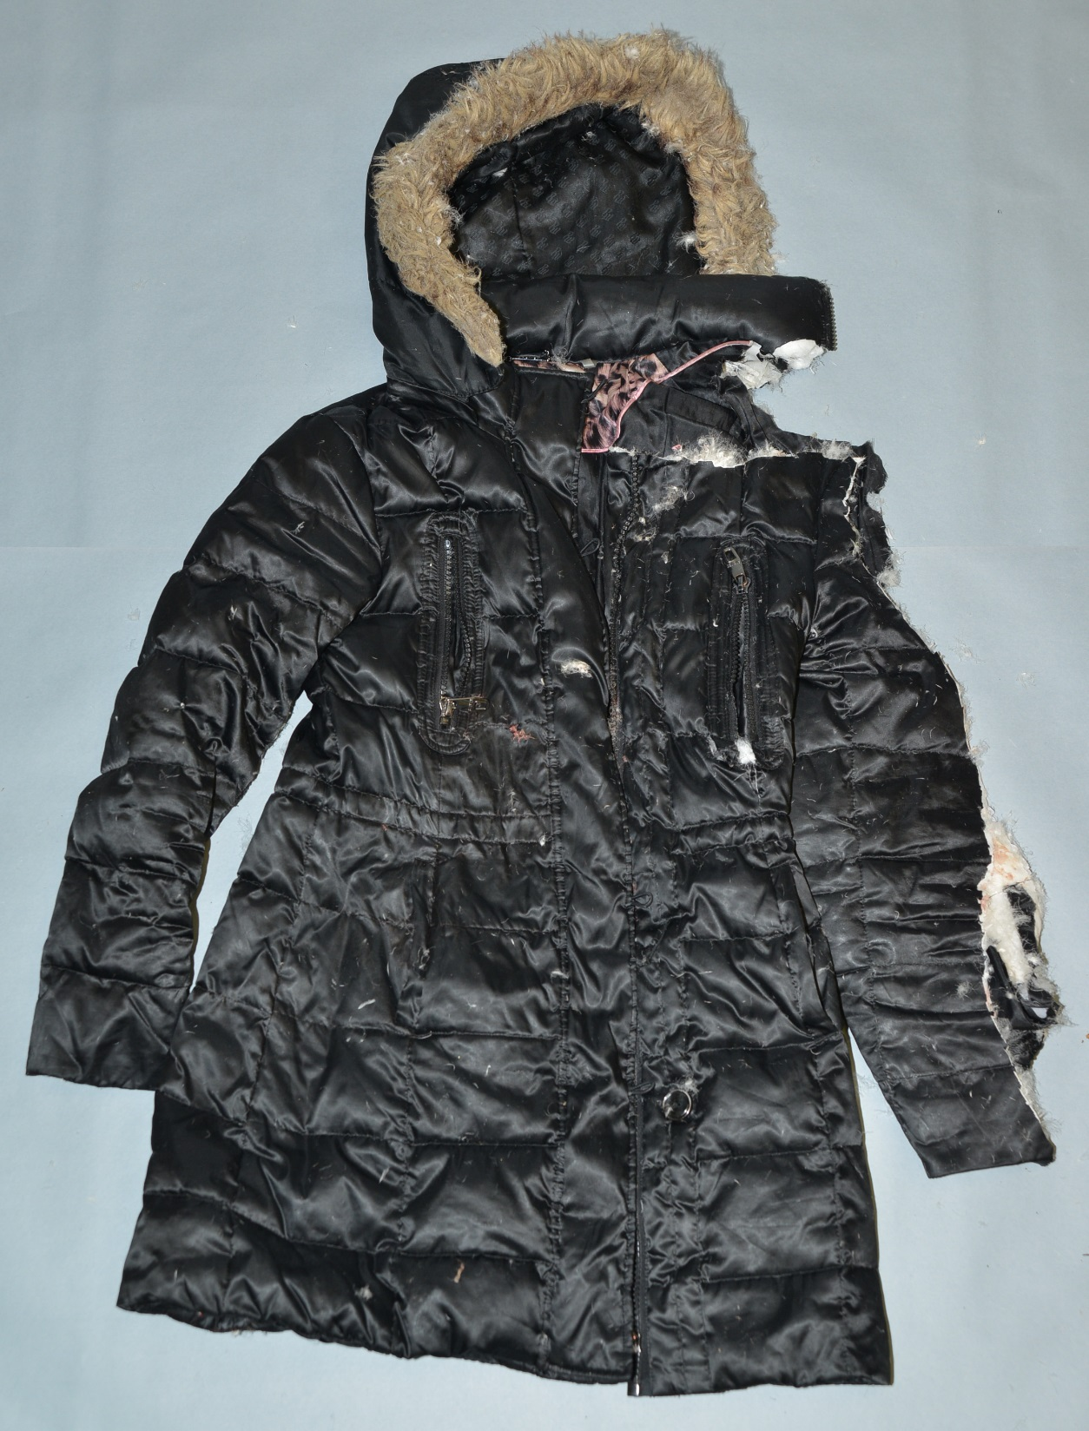
Down Parka

Slide 14
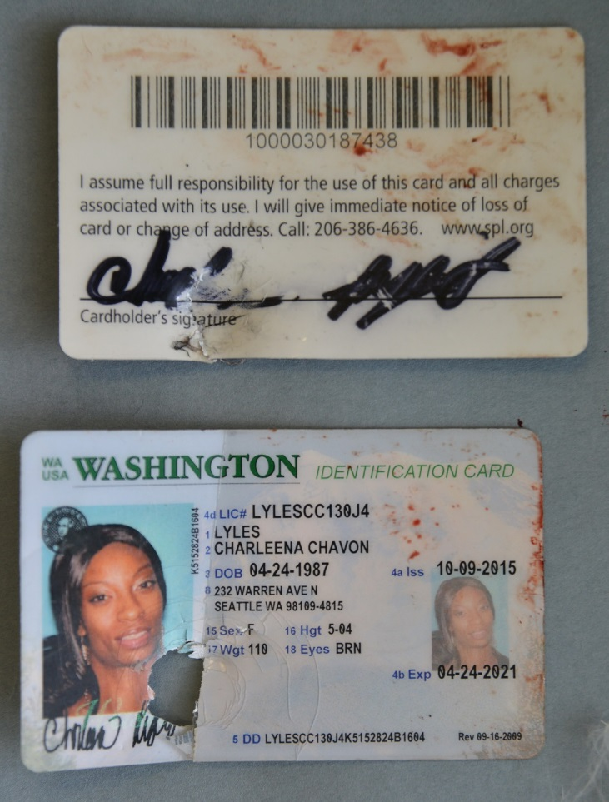
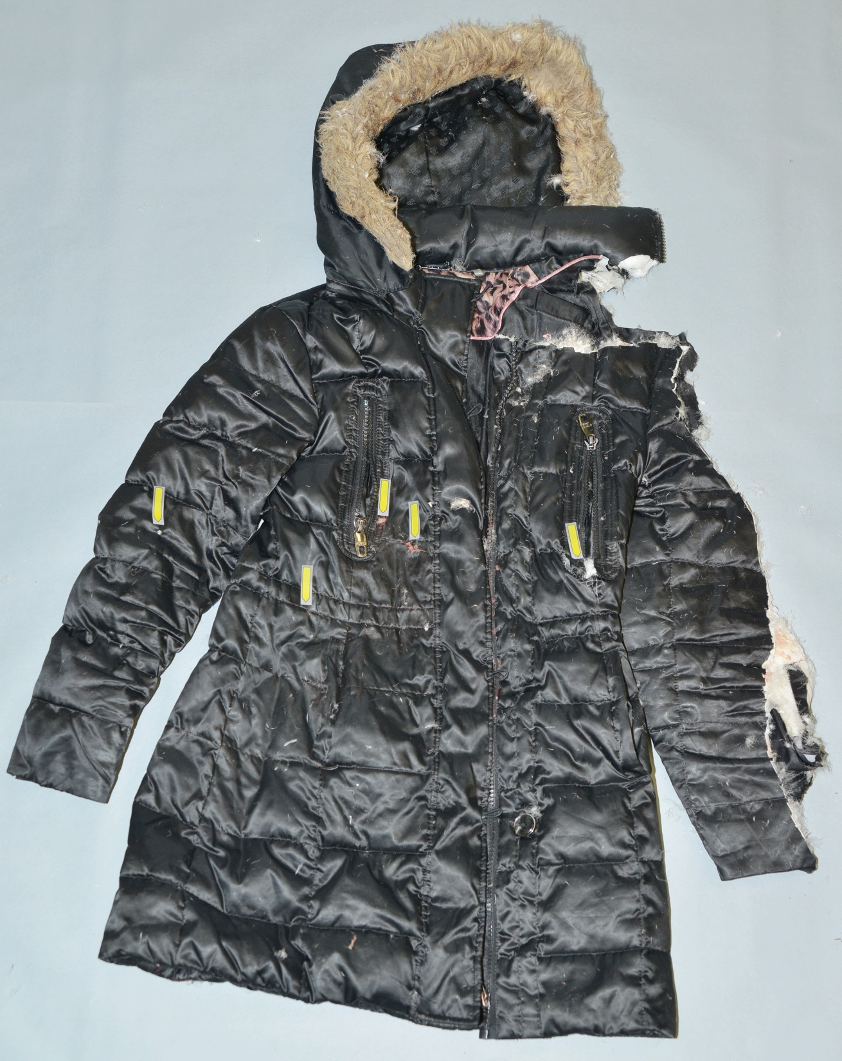
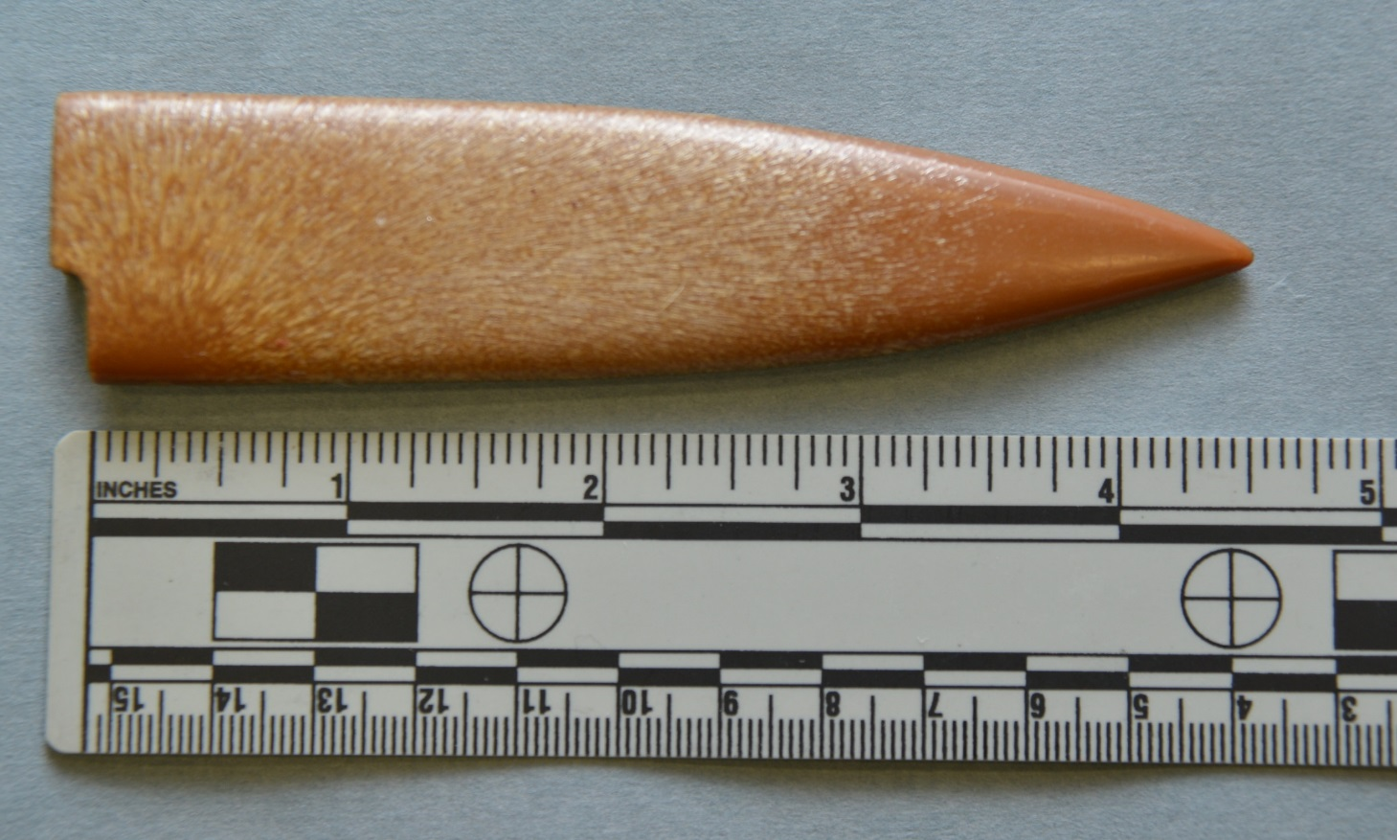
Down Parka
Library Card

Slide 15
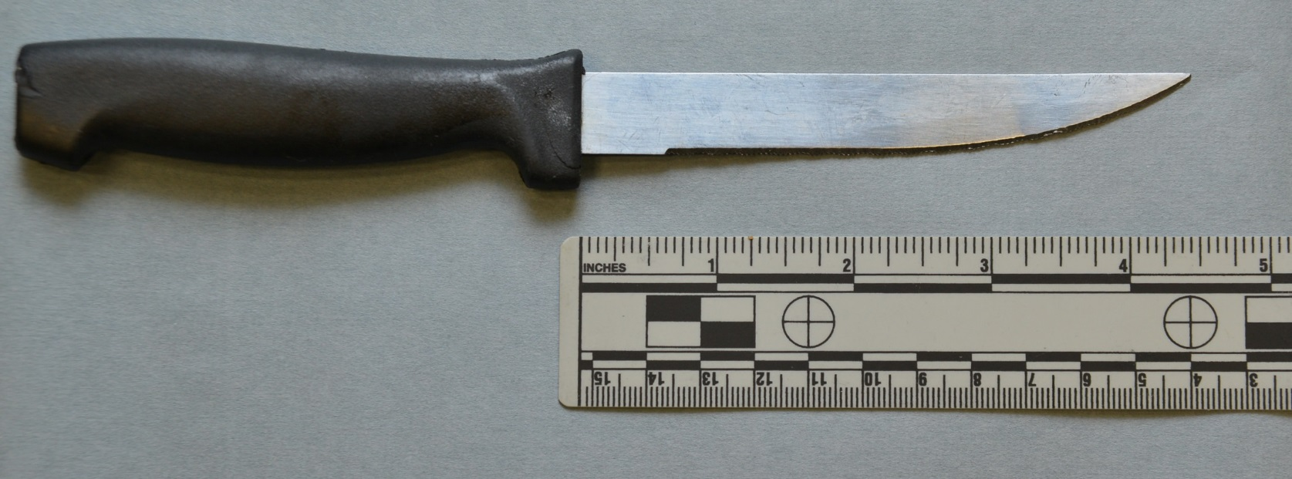
Down Parka
4.5 inch blade

Slide 16
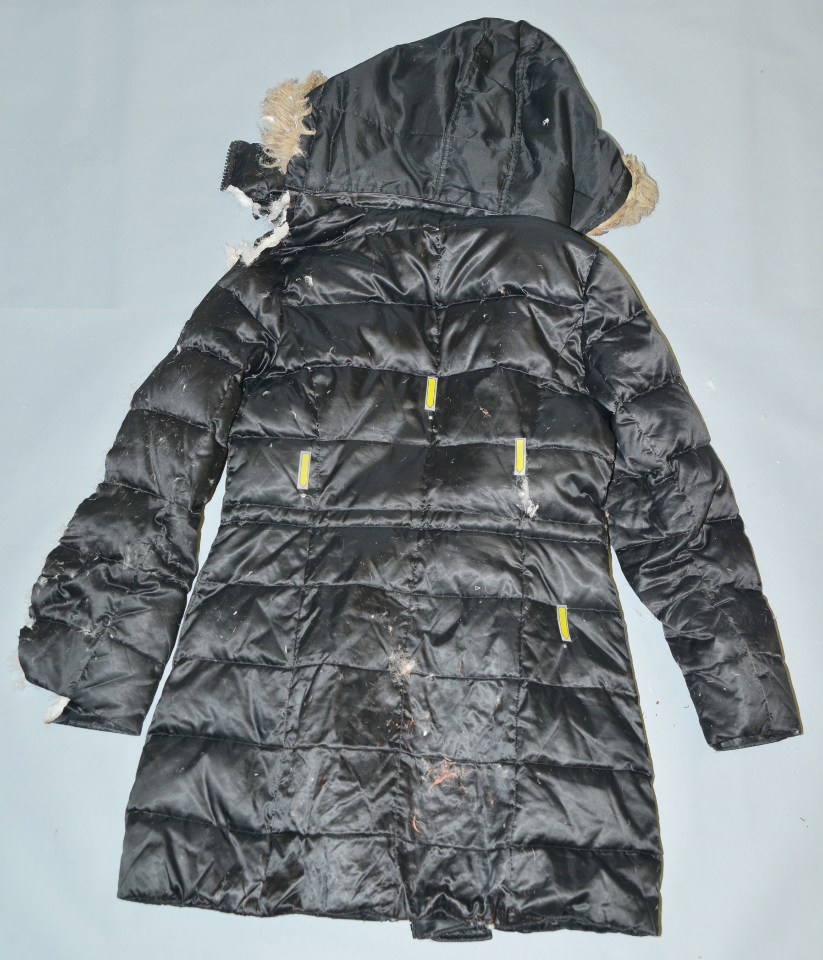
Down Parka

Slide 17
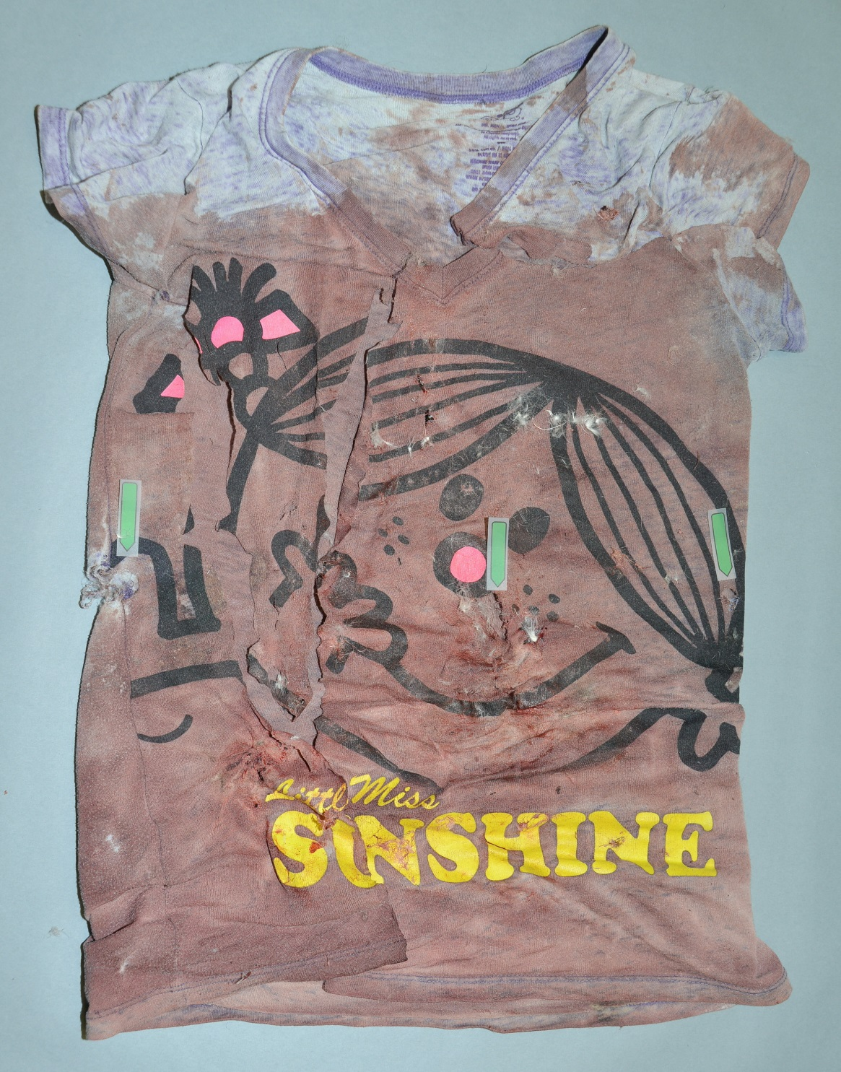
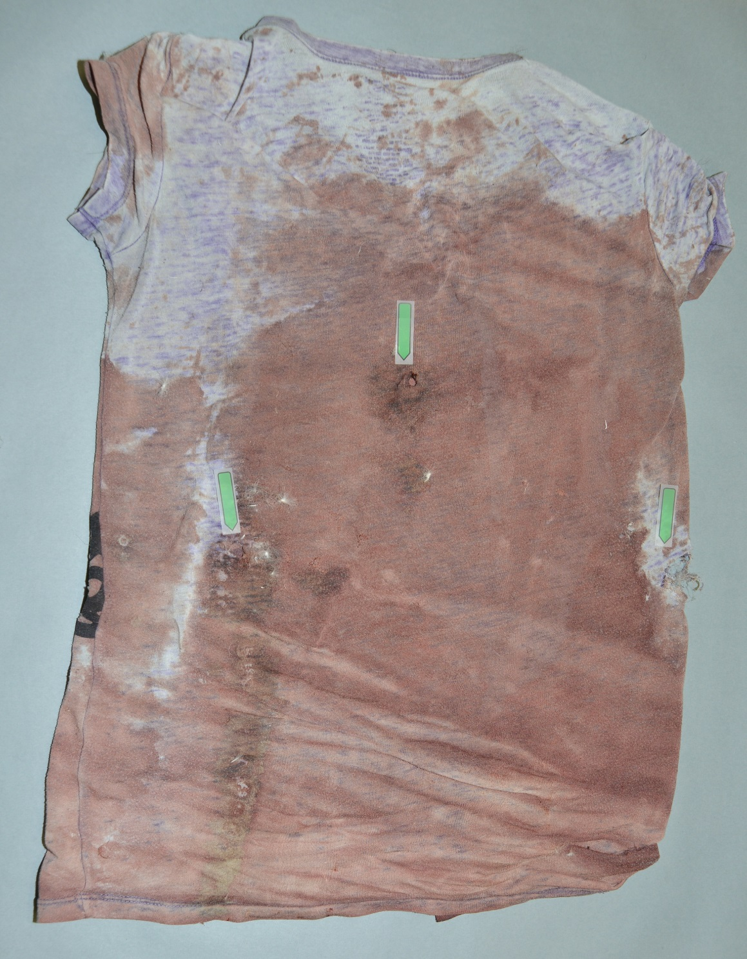
T-Shirt
Front
Back

Slide 18
Knives

Slide 19
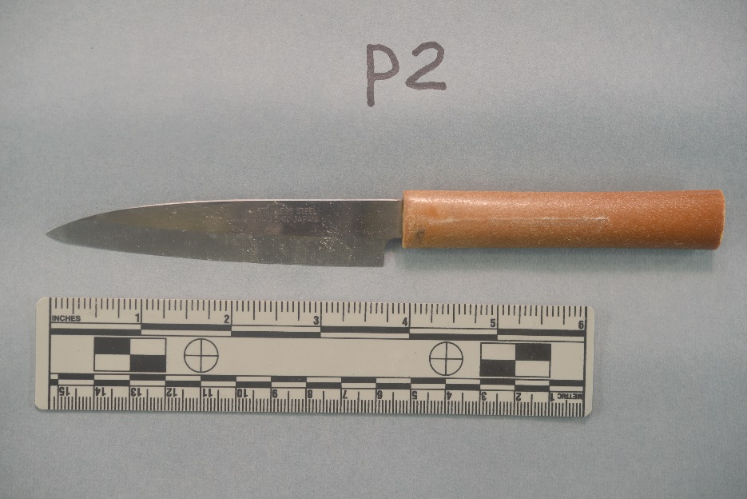
2
10
4 inch blade
Knives

Slide 20
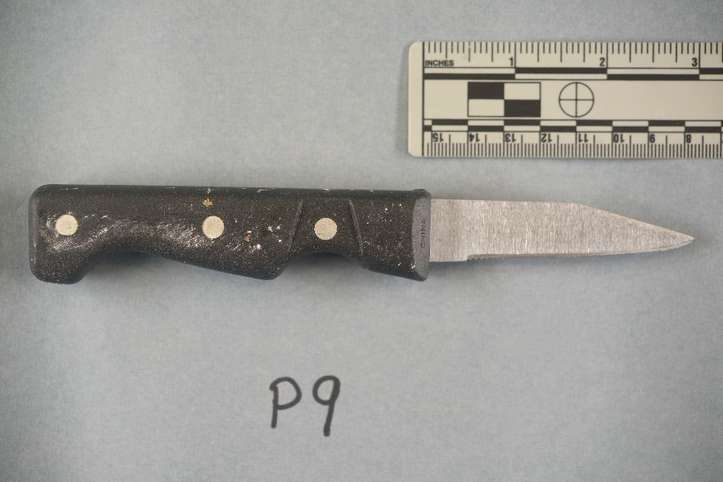
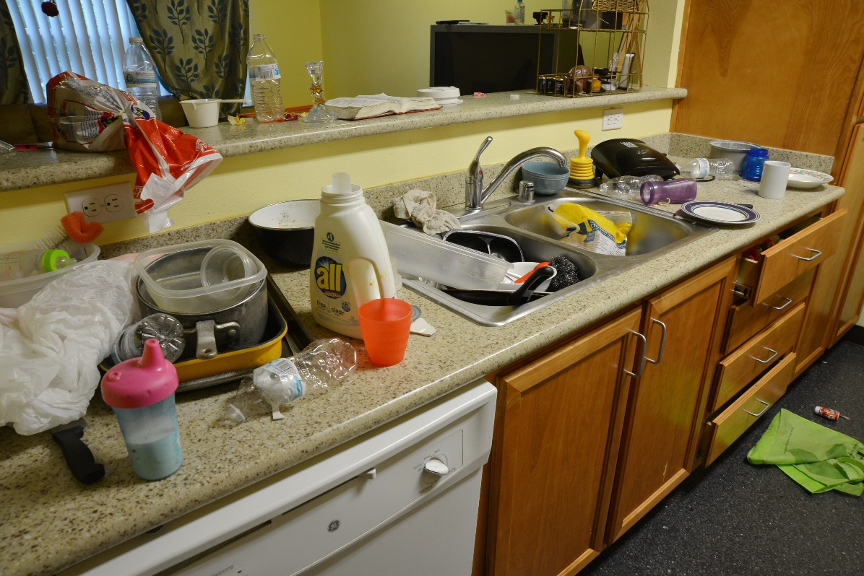
2
9
10
Knives

Slide 21
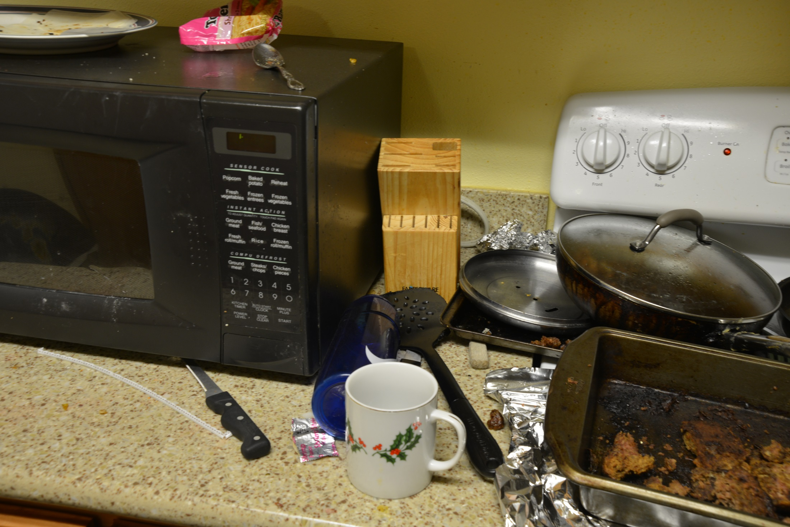
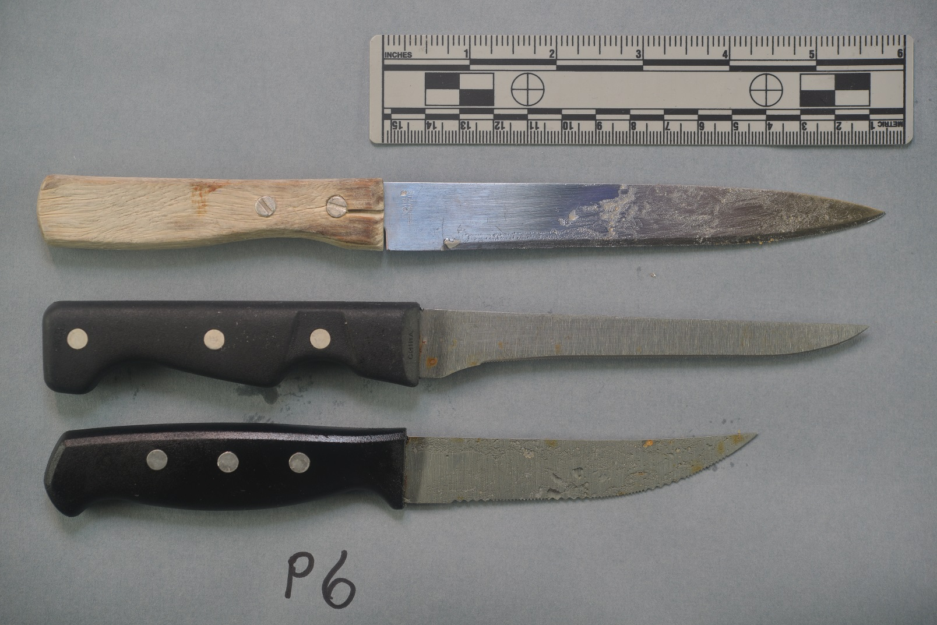
6
2
9
10
Knives

Slide 22
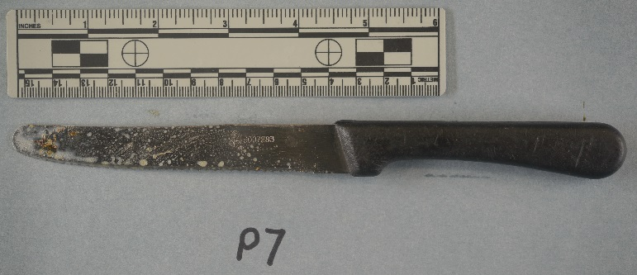
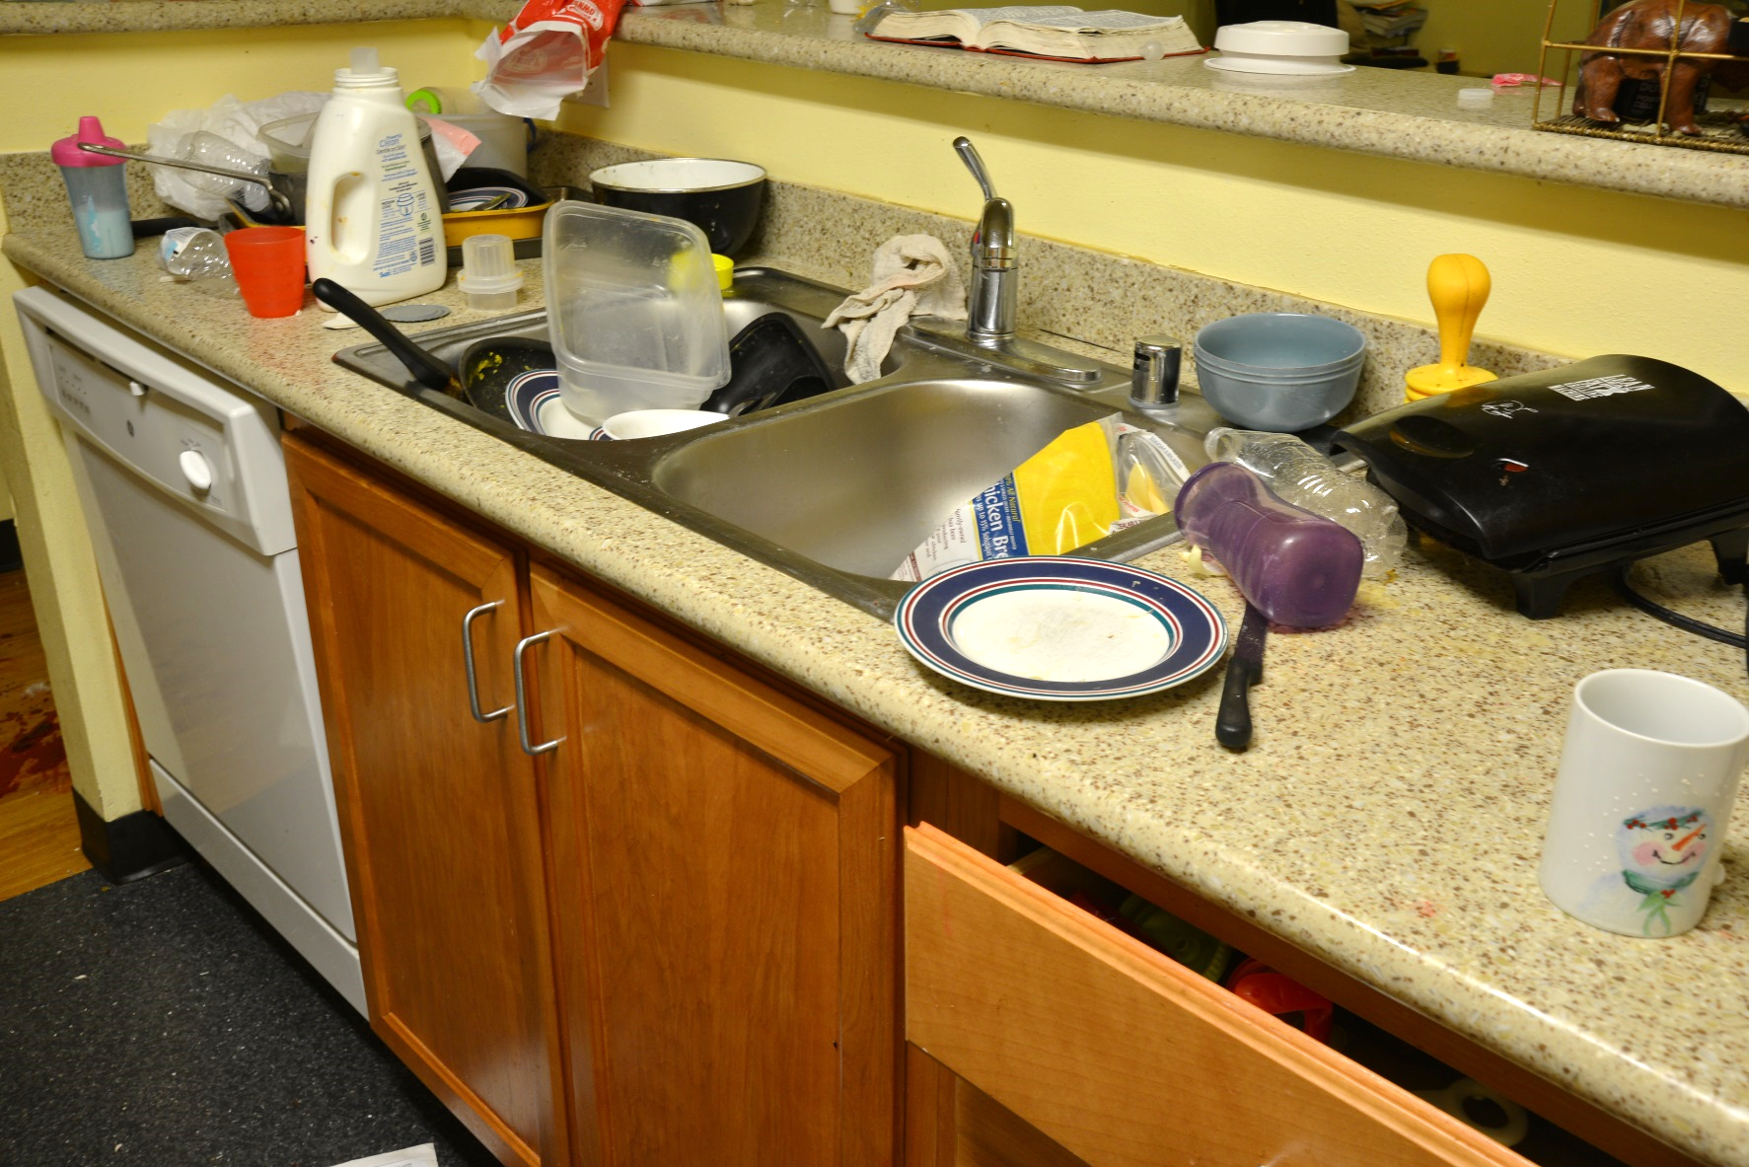
6
2
9
7
10
Knives

Slide 23
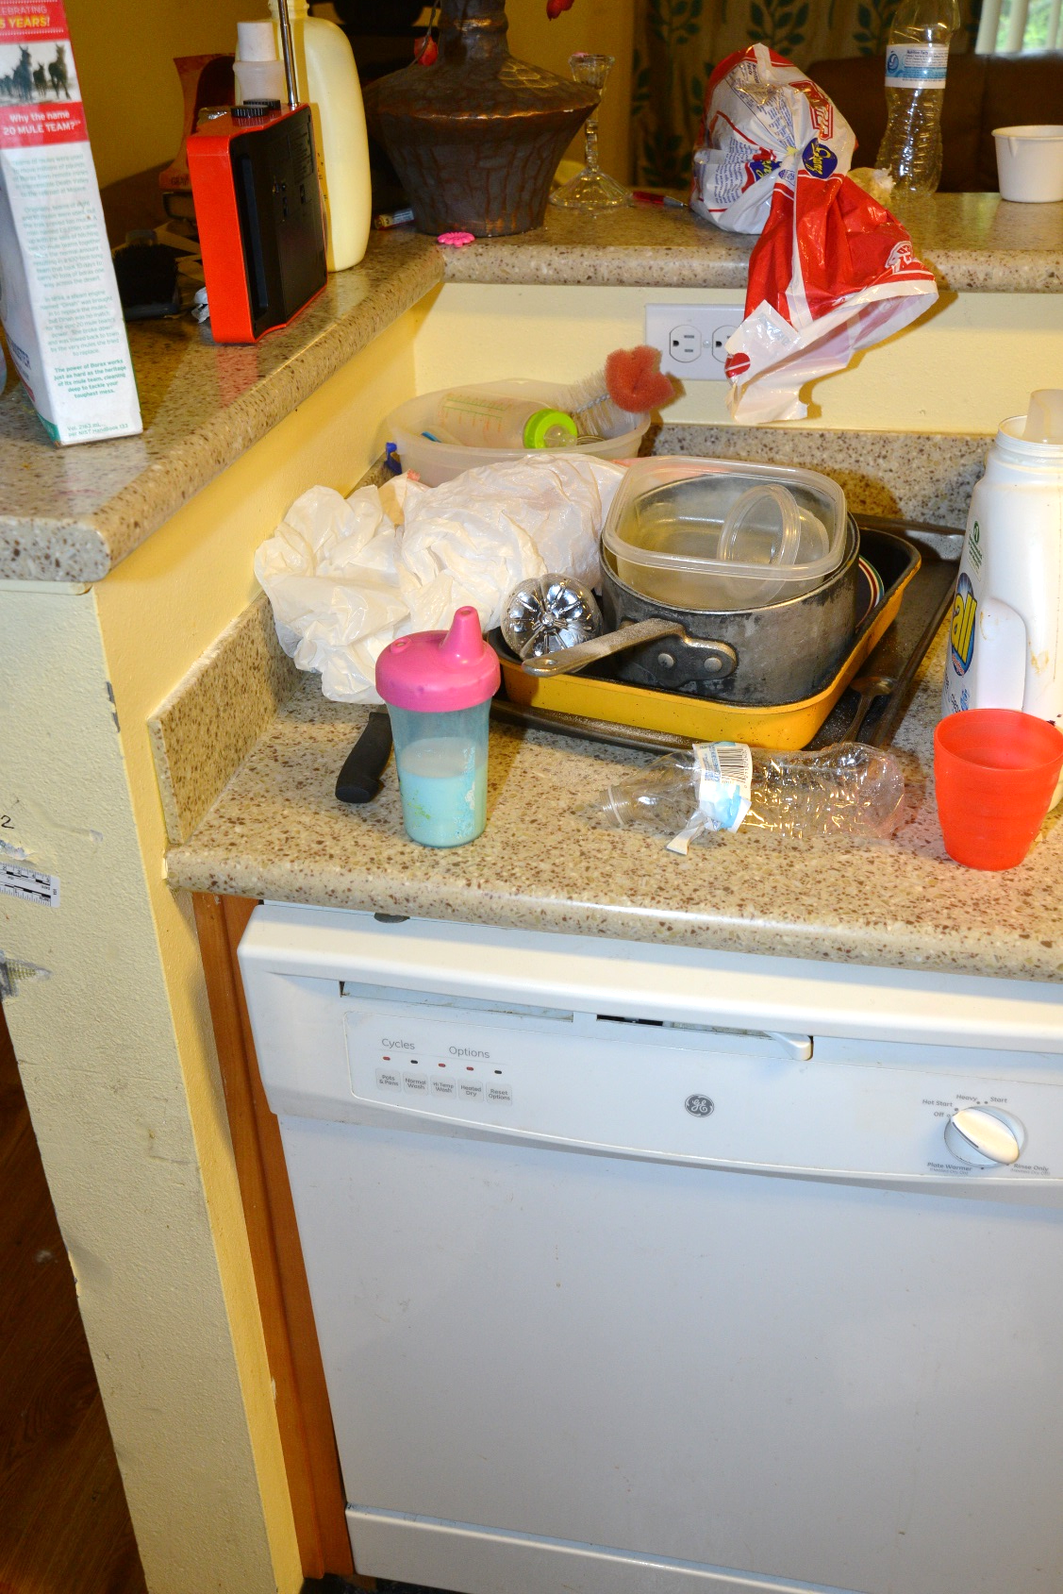
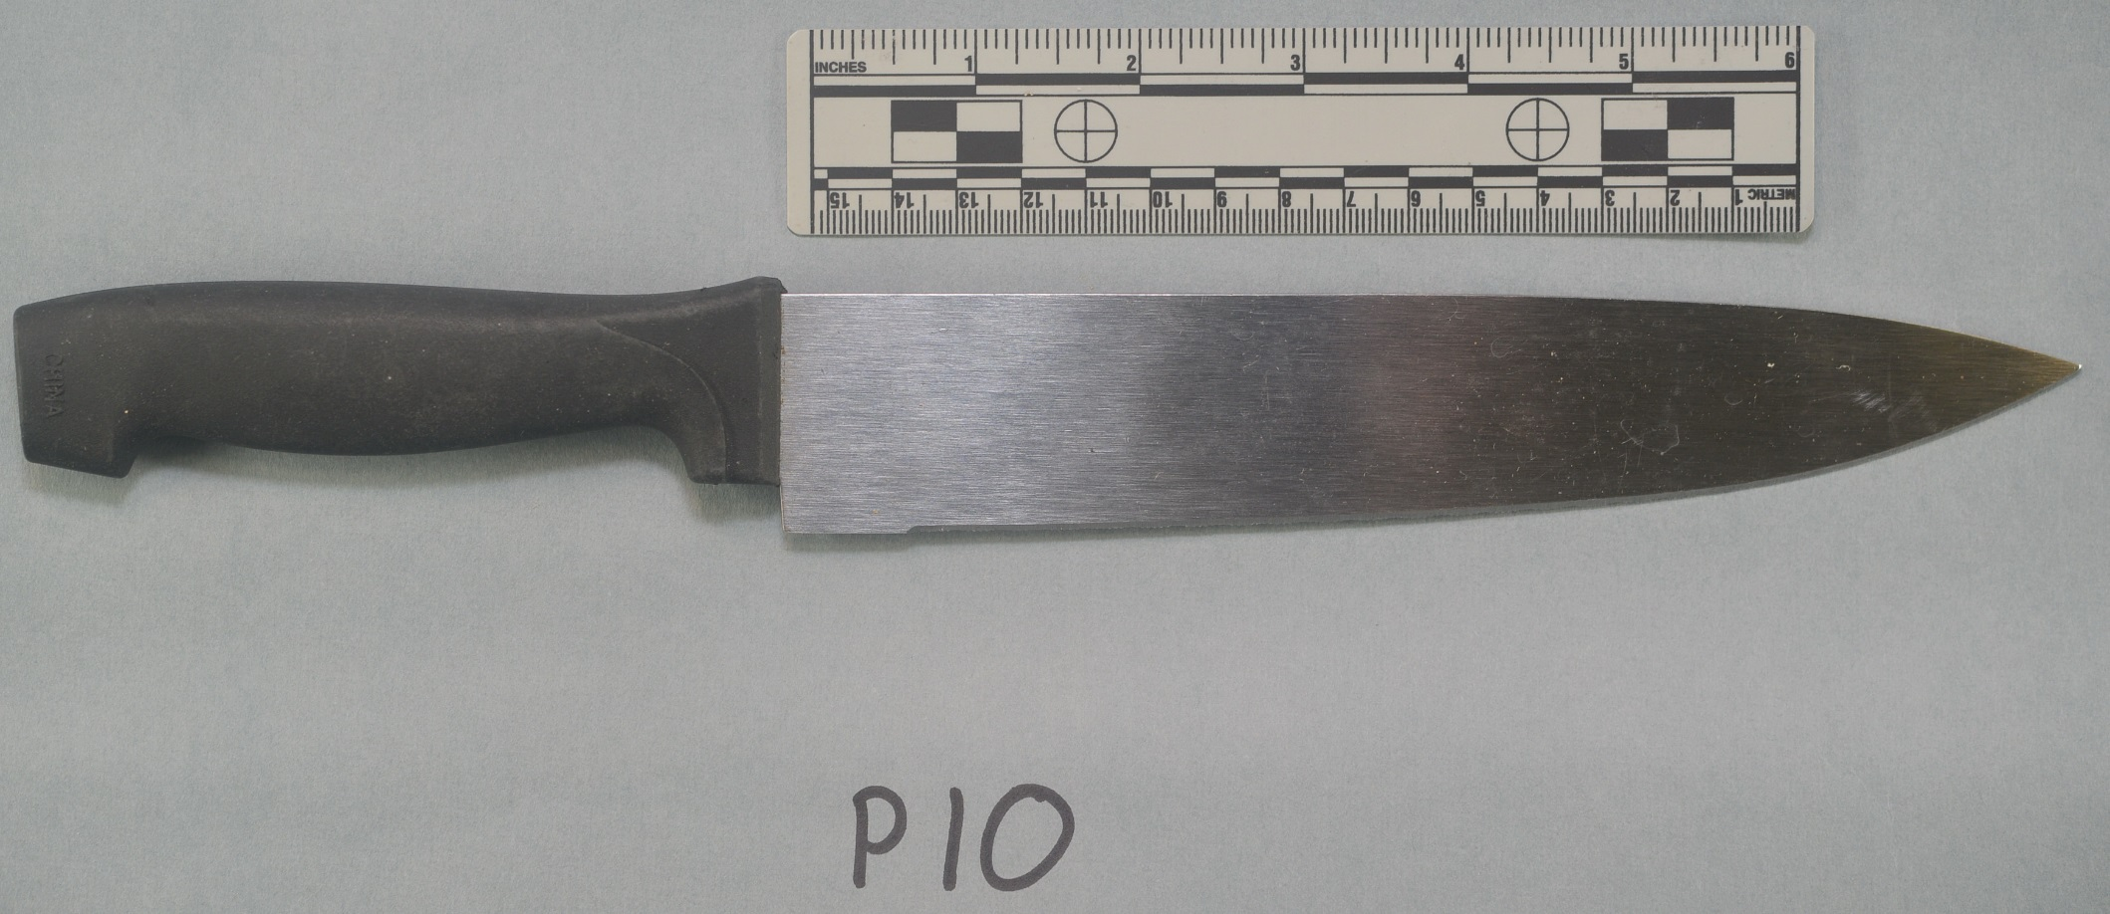
6
2
9
7
10
10
Knives

Slide 24
Fired Cartridge Cases (FCCs)
7 Total

Slide 25
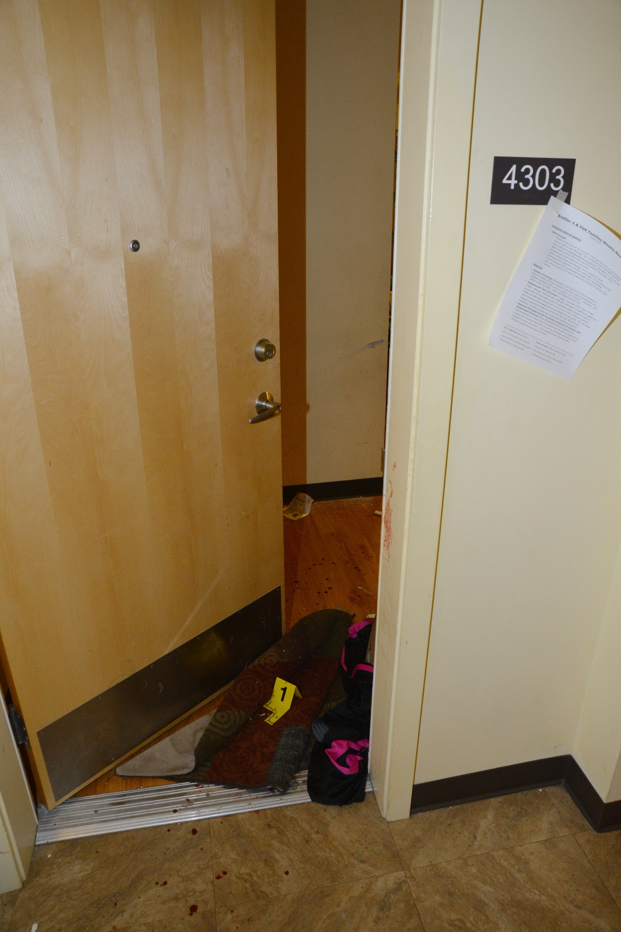
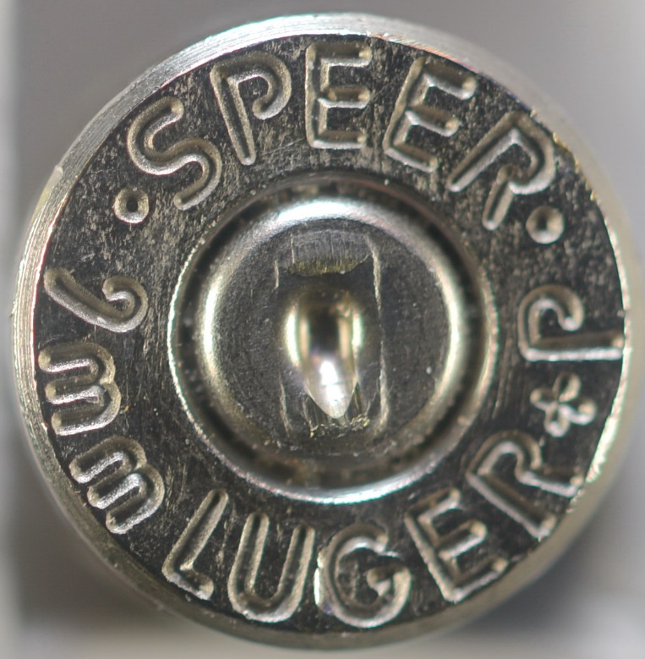
1
Fired Cartridge Cases (FCCs)

Slide 26
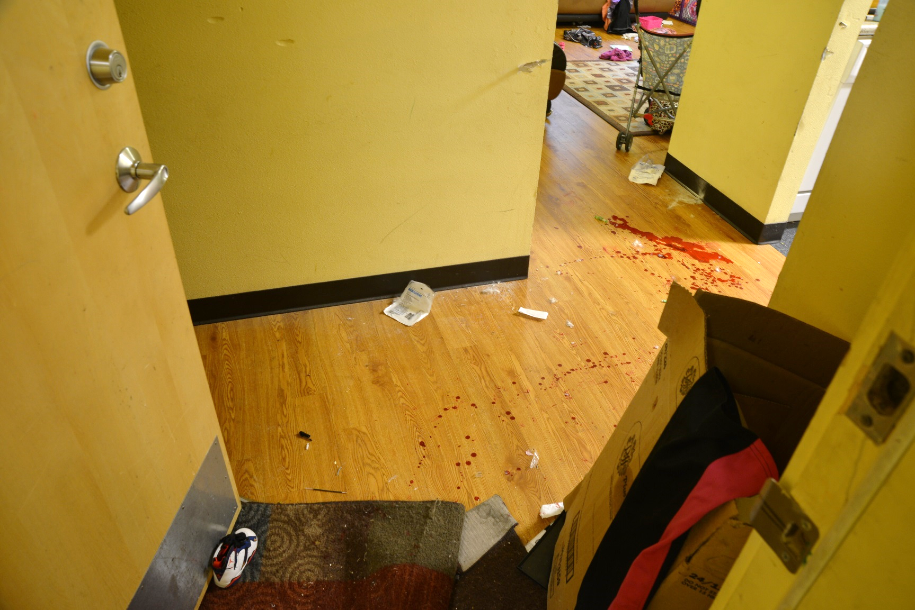
1
12
11
13
Fired Cartridge Cases (FCCs)

Slide 27
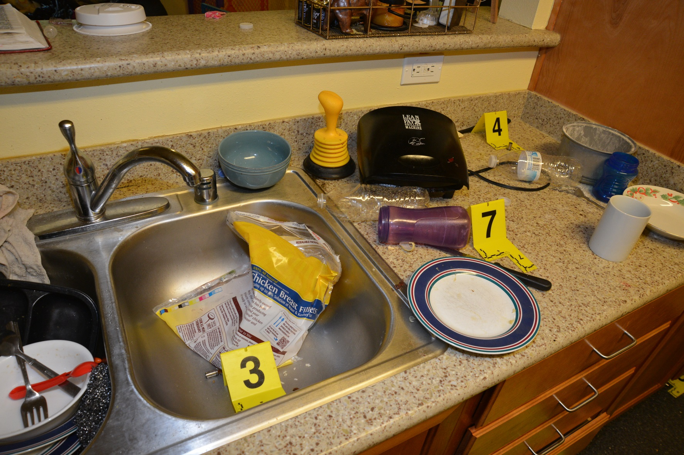
1
11
12
3
13
4
Fired Cartridge Cases (FCCs)

Slide 28
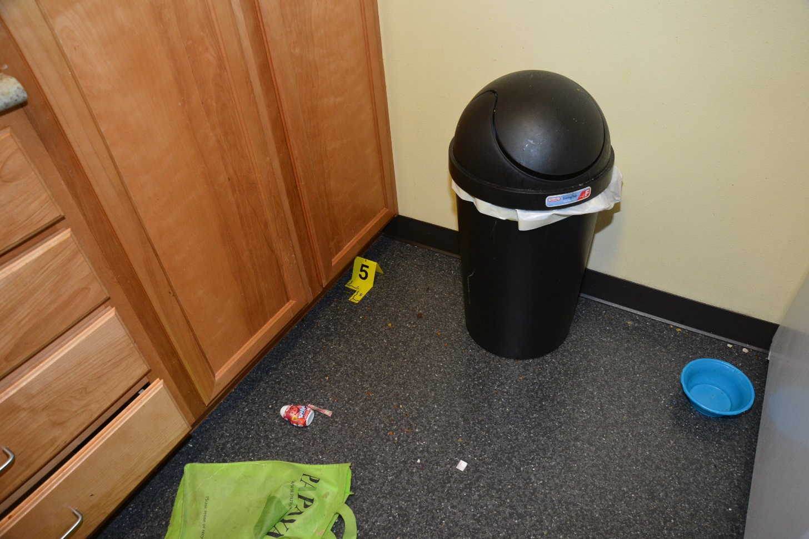
1
11
12
3
13
5
4
Fired Cartridge Cases (FCCs)

Slide 29
1
11
12
4 Entry Way
3
13
5
4
3 Kitchen
Fired Cartridge Cases (FCCs)
7 Total

Slide 30
Bullet Defects #1-4

Slide 31
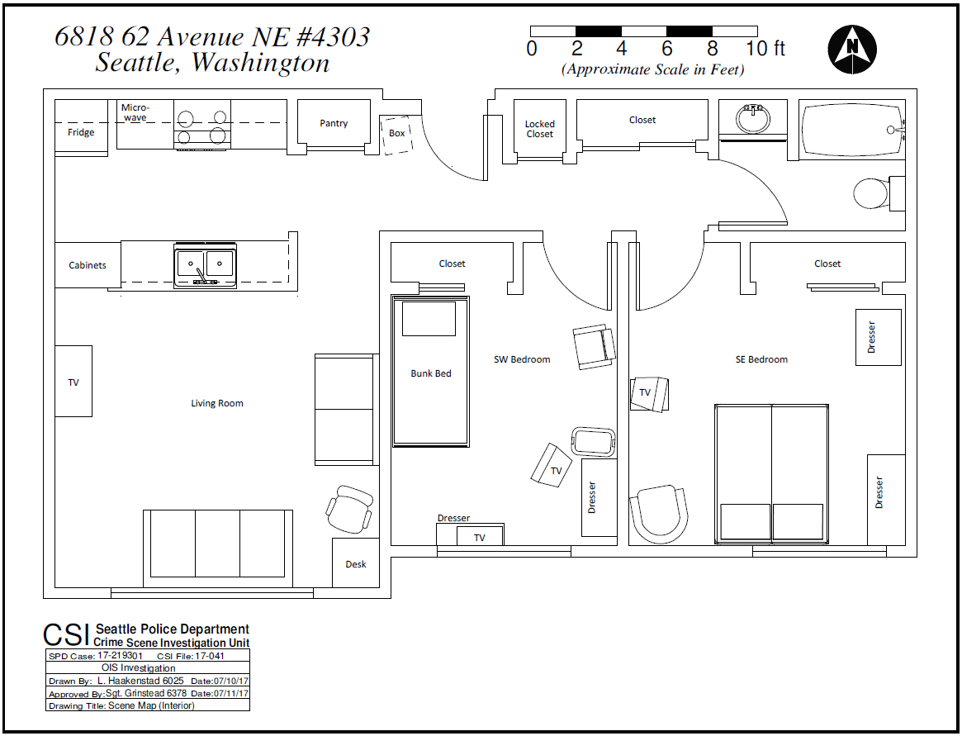
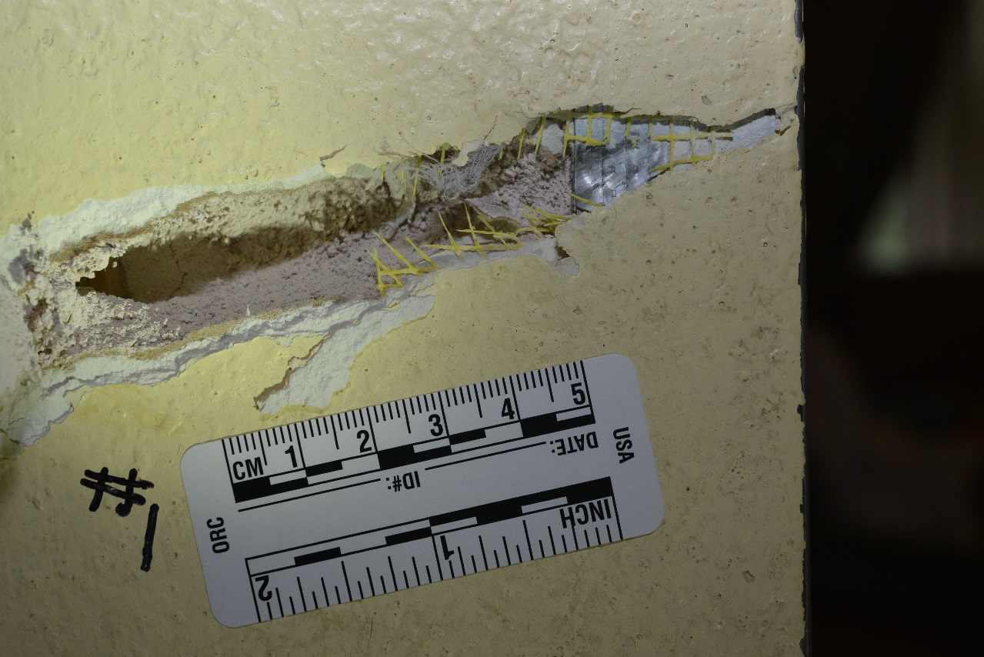
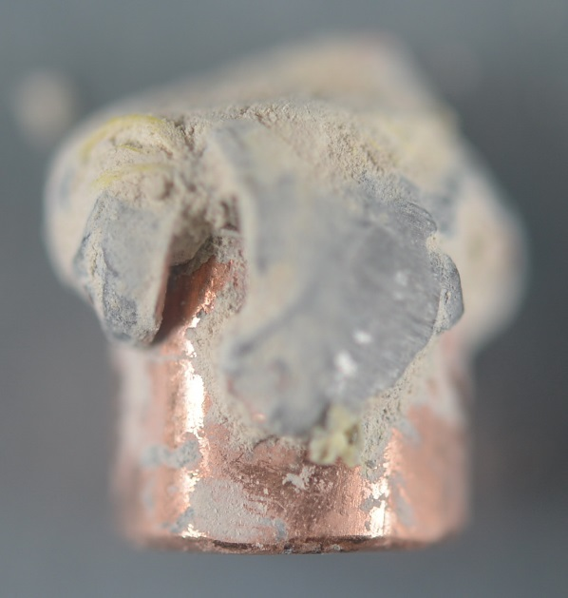
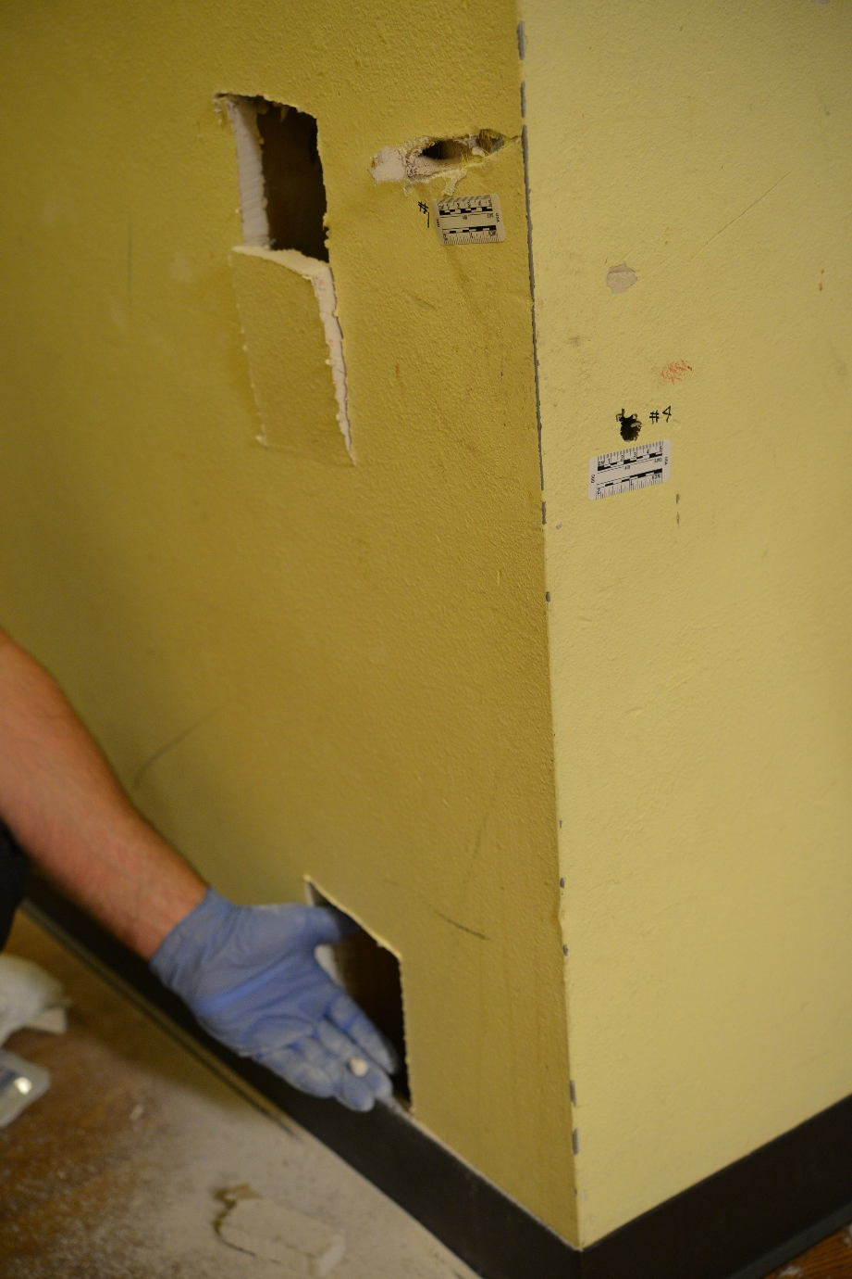
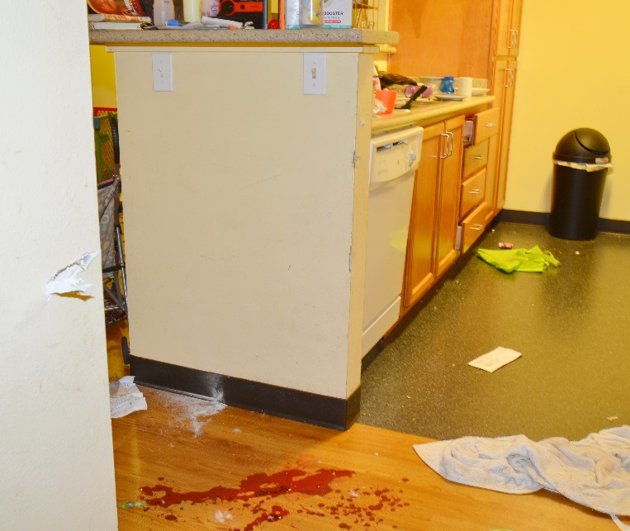
1
D1

Slide 32
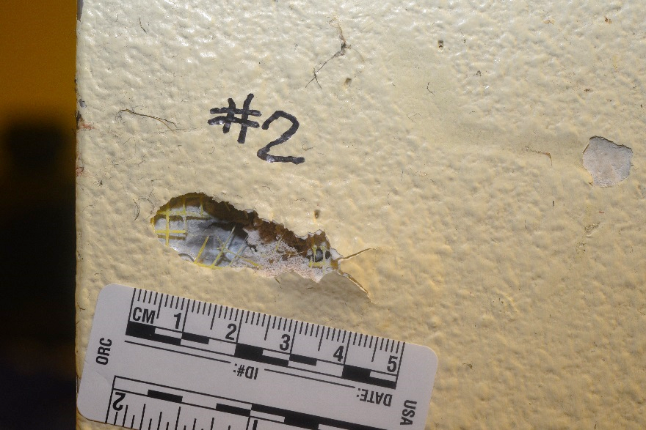
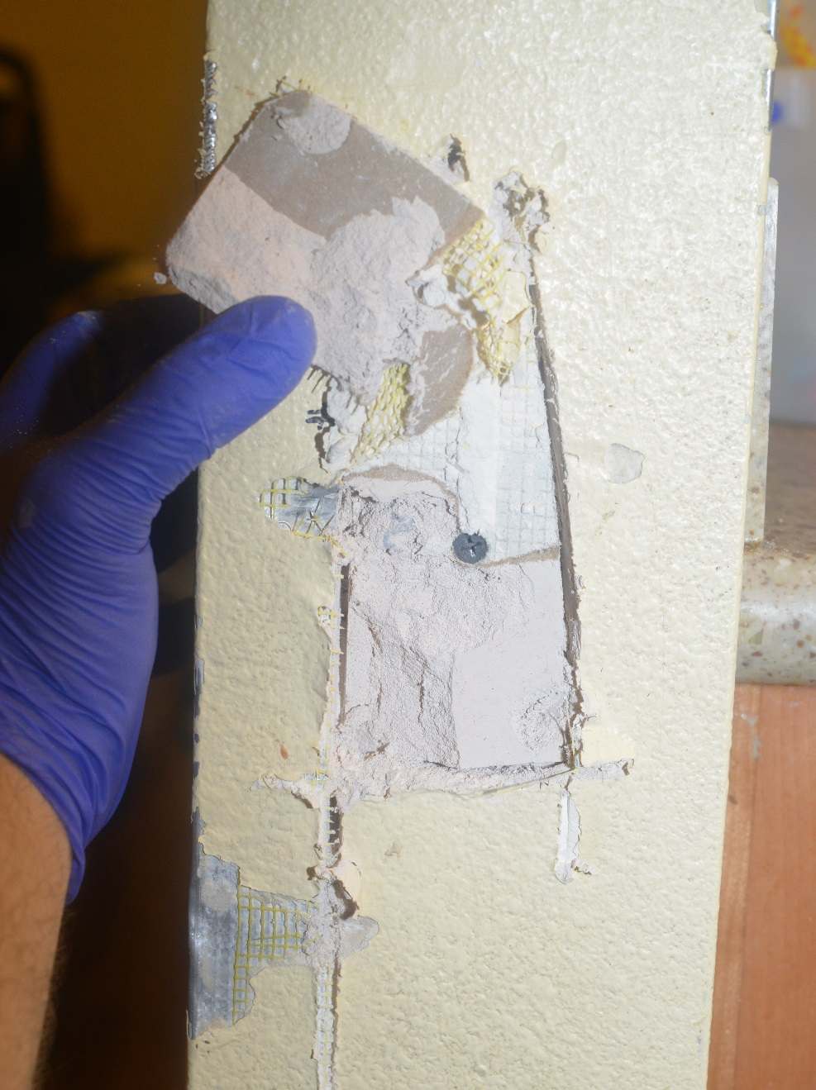
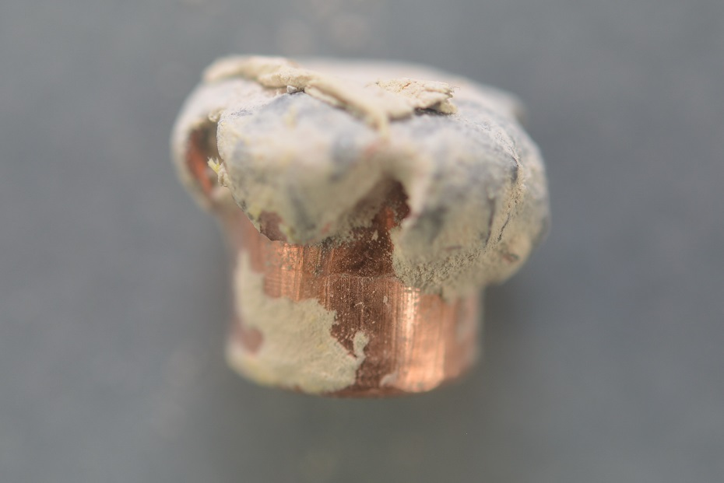
2
D2

Slide 33
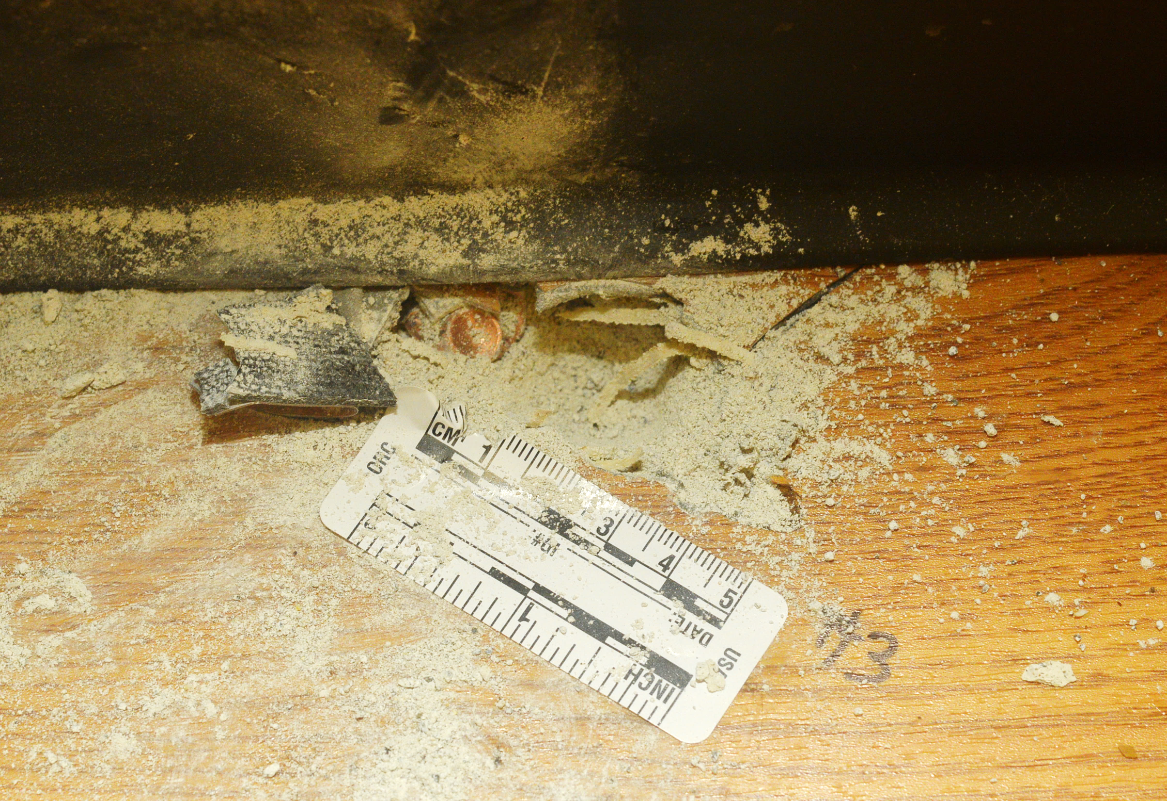
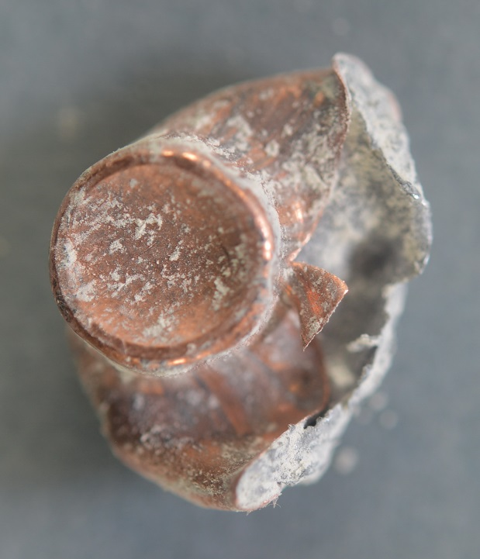
3
D3

Slide 34
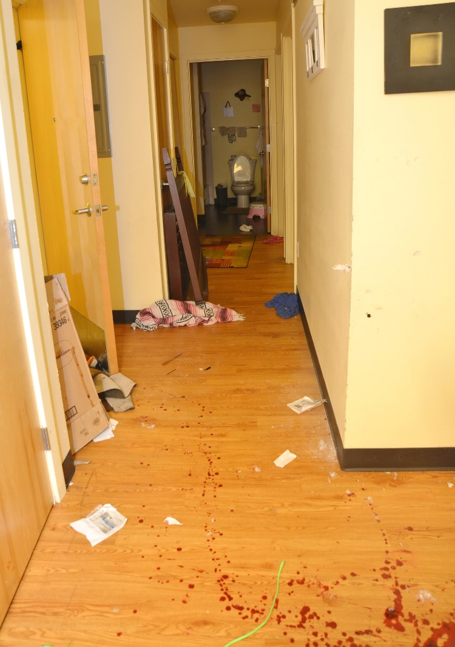
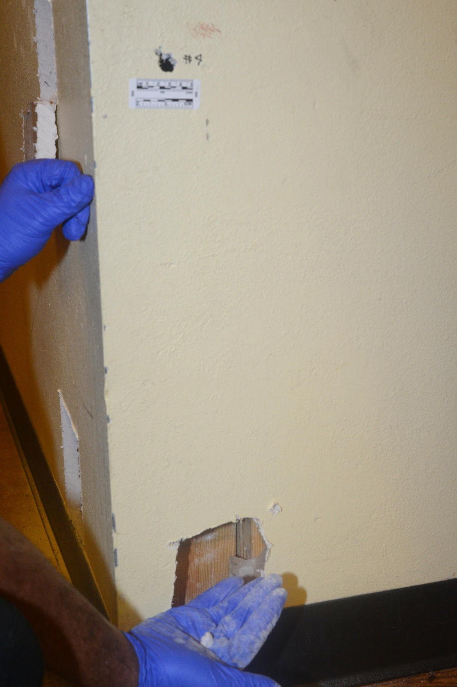
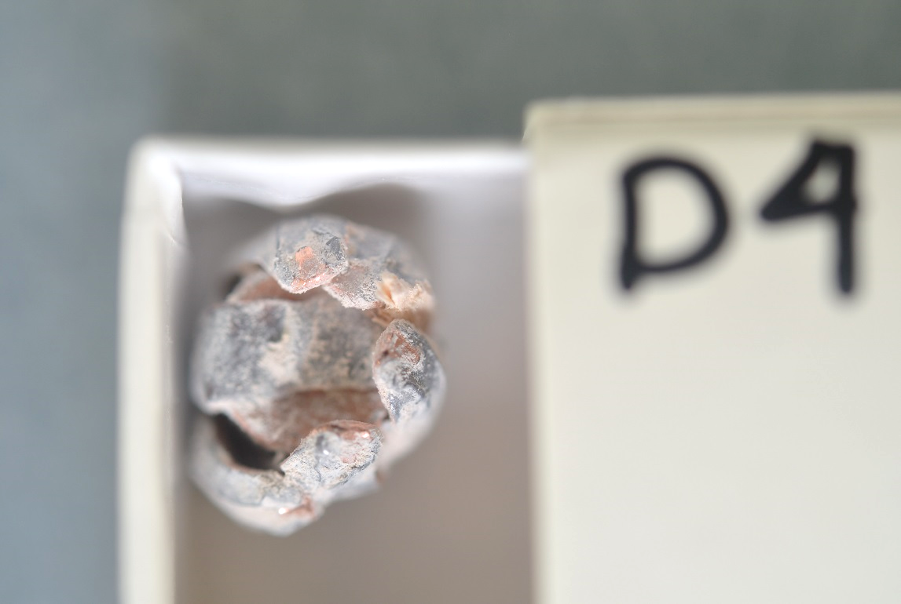
4
D4

Slide 35
2
1
3
4
Bullet Defects 2 & 3: from entryway
Bullet Defects 1 & 4: from kitchen

Slide 36
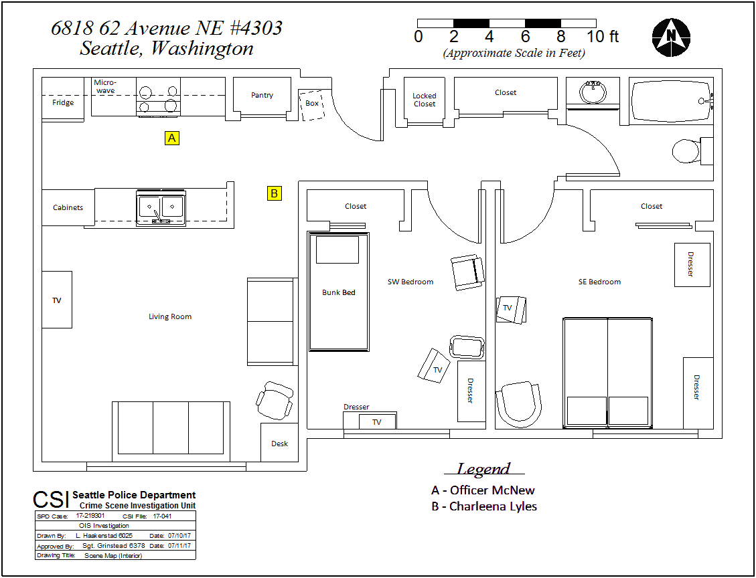

Slide 37
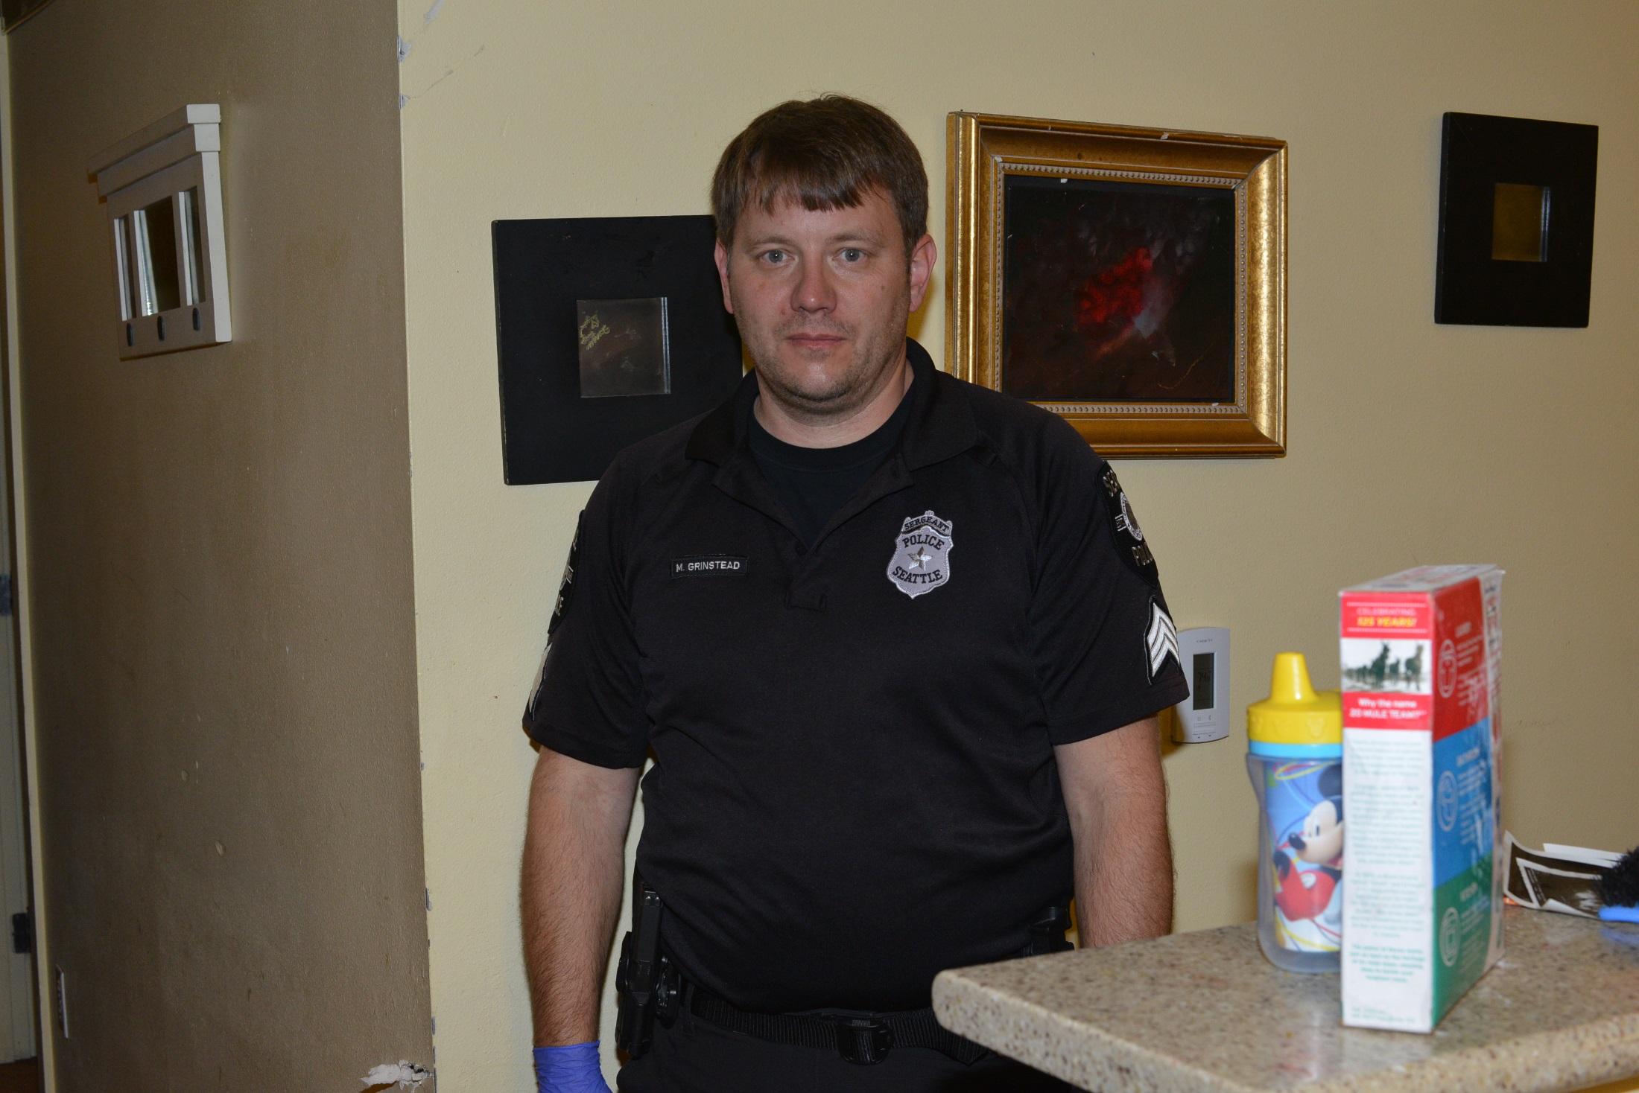
Officer McNew’s View

Slide 38
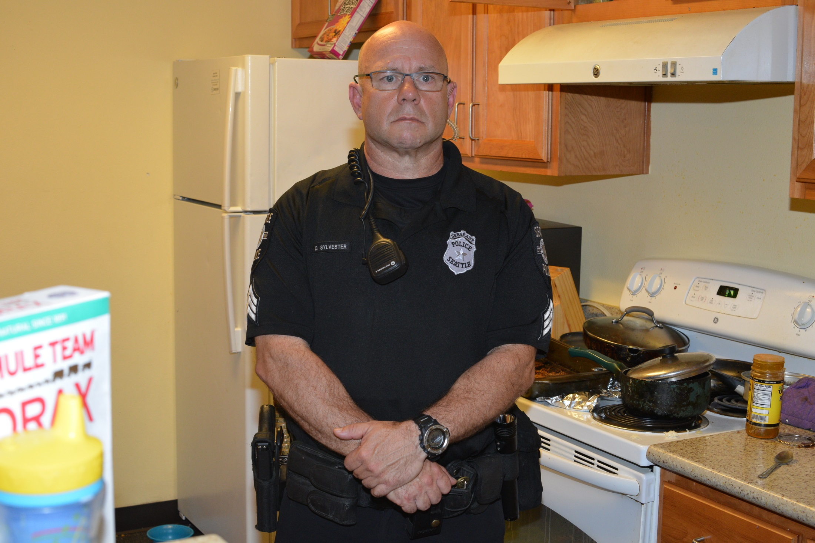
Lyles’ View

Slide 39
Autopsy Report: 3 Bullets Recovered

Slide 40
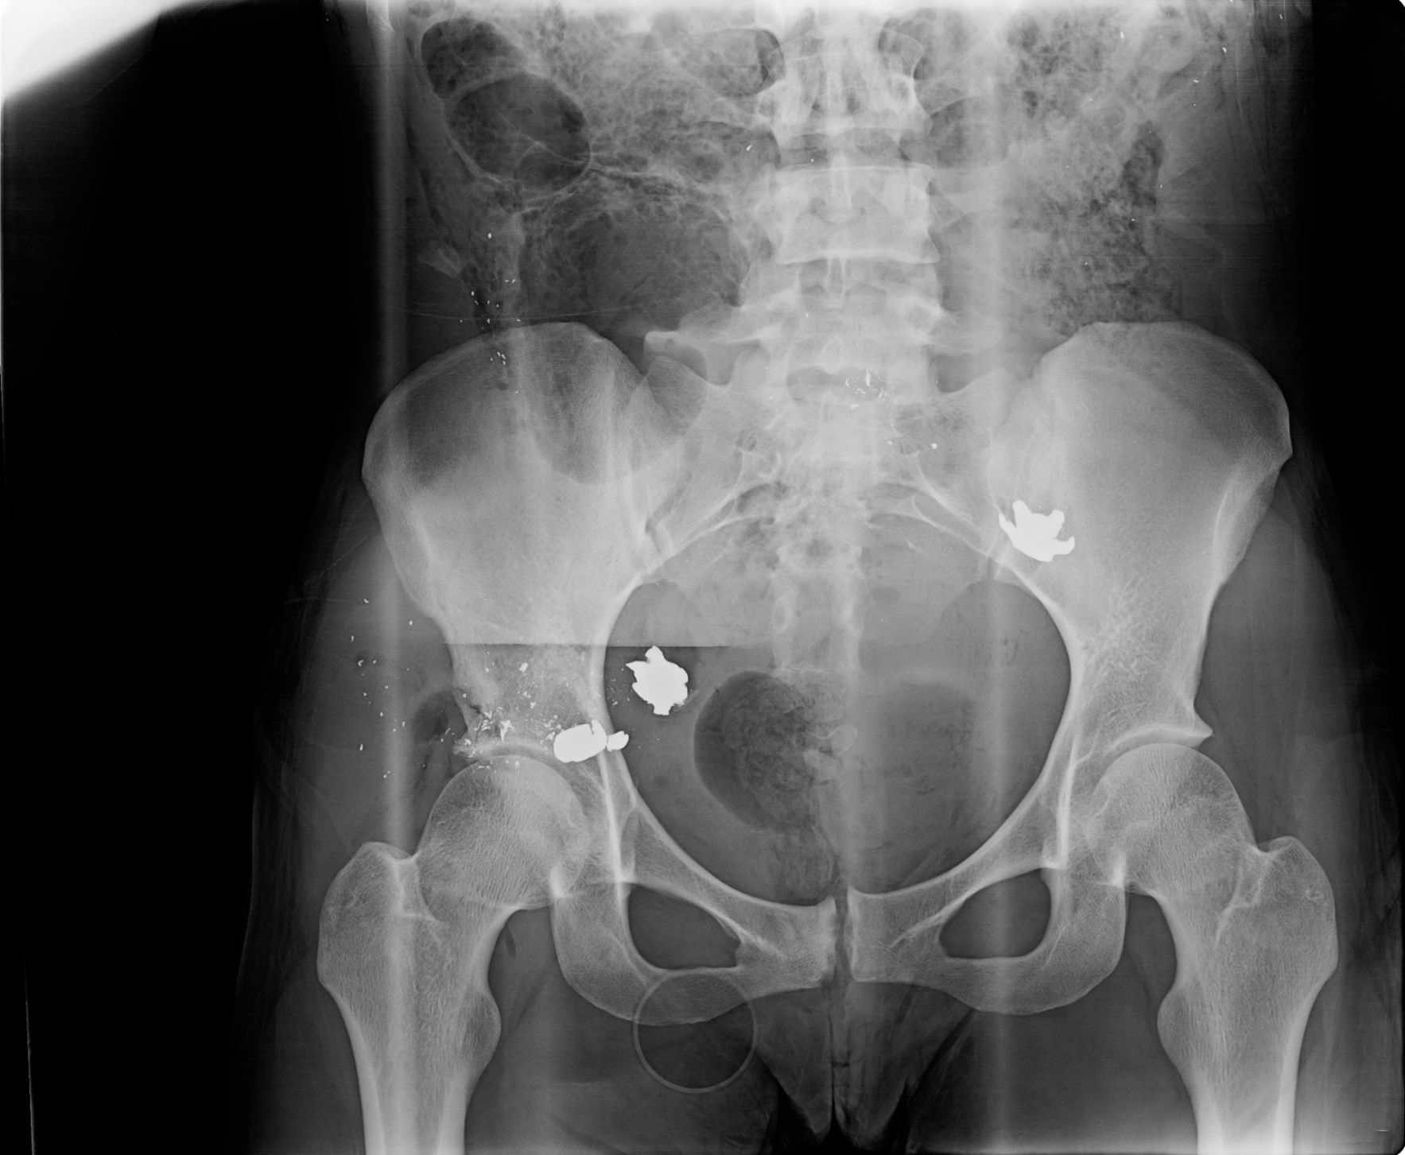

Slide 41
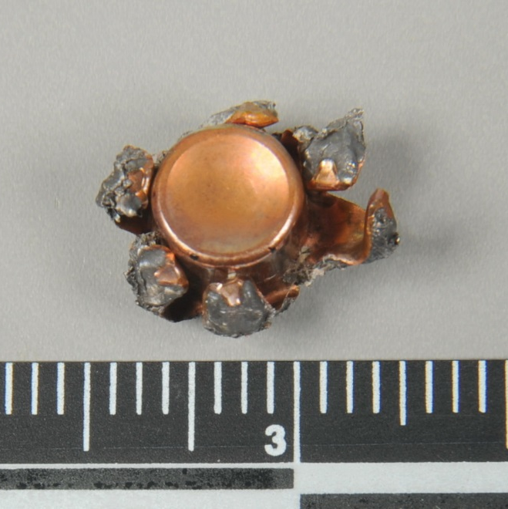
Right Pelvis
Right Buttock
Left Pelvis

Slide 42
Shot Accounting Recovered FCC and Recovered Fired Bullets
FCCs | Number
Speer 9mm Luger +P (Scene) | 7
Fired Bullets | Number
Scene | 4
Autopsy | 3
TOTAL | 7

Slide 43
Non-Bullet Defects #5

Slide 44
5
Defect 5 Tested Negative for Copper and Lead

